Slide 1
Chapters 14 and 15 – Linear Regression and Correlation

Slide 2
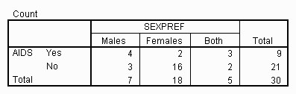
Contingency tables are useful for displaying information on two qualitative variables

Slide 3
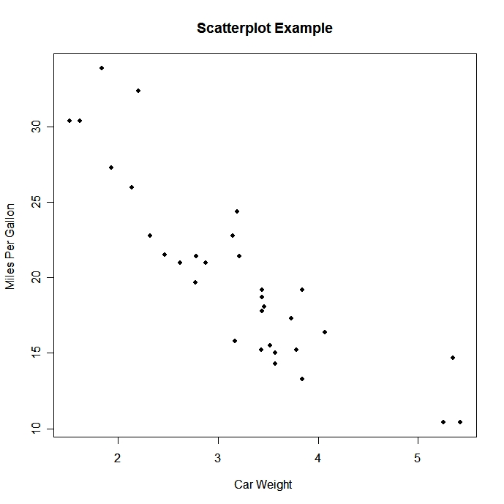
Scatter plots are useful for displaying information on two quantitative variables.

Slide 4
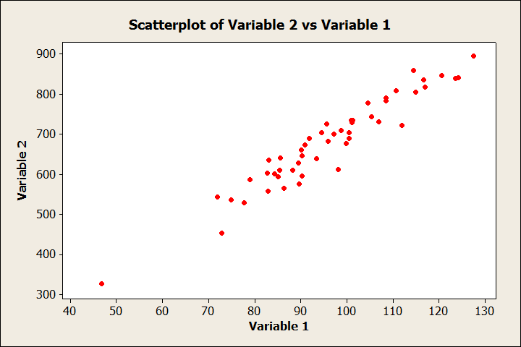
What type of relationship is present in the following scatter plot?
No relationship
Linear relationship
Quadratic relationship
Other type of relationship

Slide 5
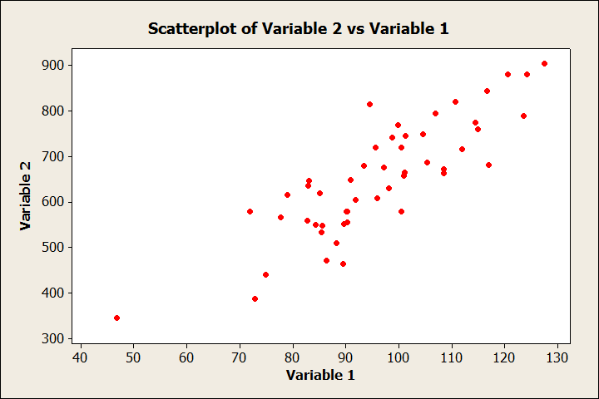
What type of relationship is present in the following scatter plot?
No relationship
Linear relationship
Quadratic relationship
Other type of relationship

Slide 6
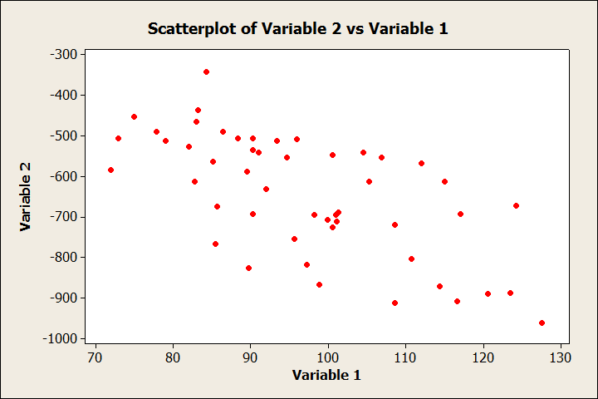
What type of relationship is present in the following scatter plot?
No relationship
Linear relationship
Quadratic relationship
Other type of relationship

Slide 7
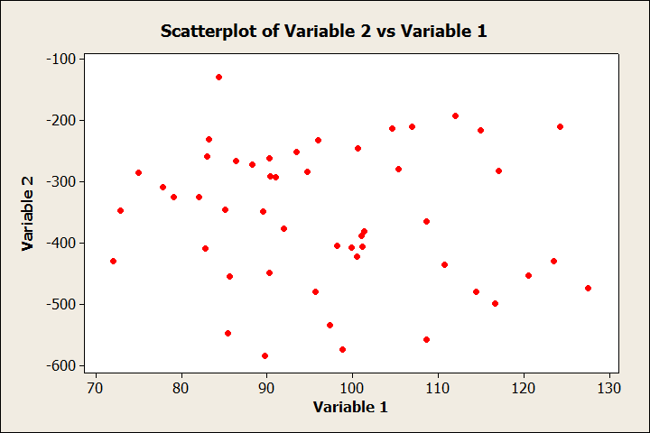
What type of relationship is present in the following scatter plot?
No relationship
Linear relationship
Quadratic relationship
Other type of relationship

Slide 8
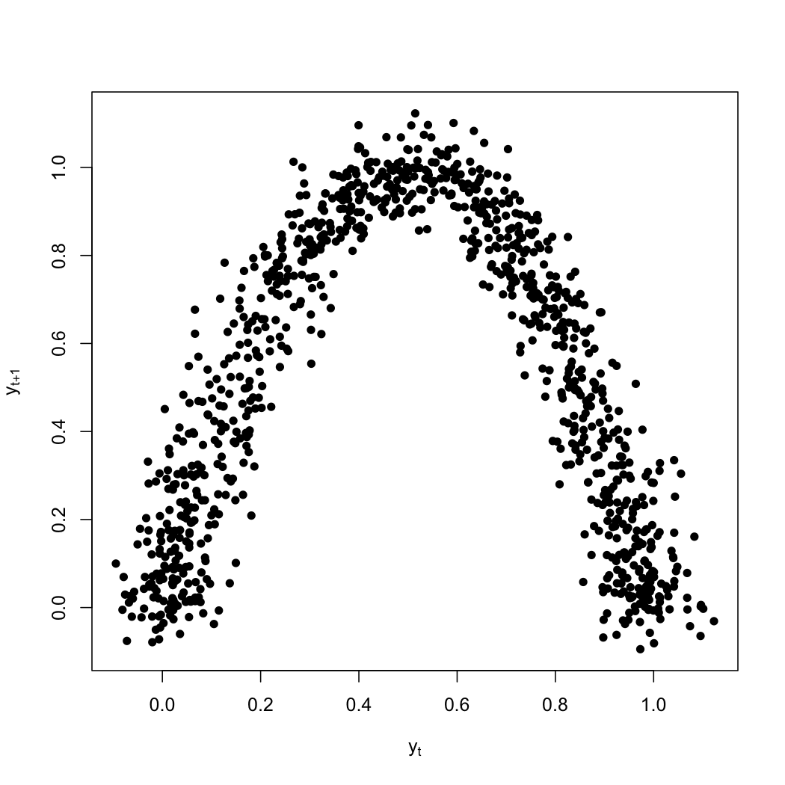
What type of relationship is present in the following scatter plot?
No relationship
Linear relationship
Quadratic relationship
Other type of relationship

Slide 9
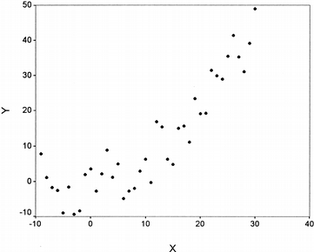
What type of relationship is present in the following scatter plot?
No relationship
Linear relationship
Quadratic relationship
Other type of relationship

Slide 10
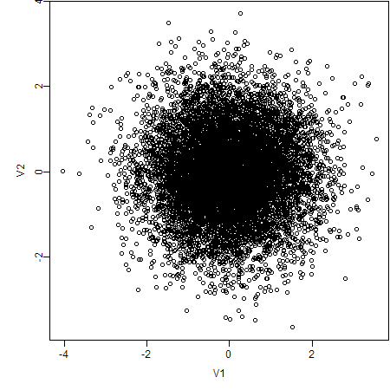
What type of relationship is present in the following scatter plot?
No relationship
Linear relationship
Quadratic relationship
Other type of relationship

Slide 11
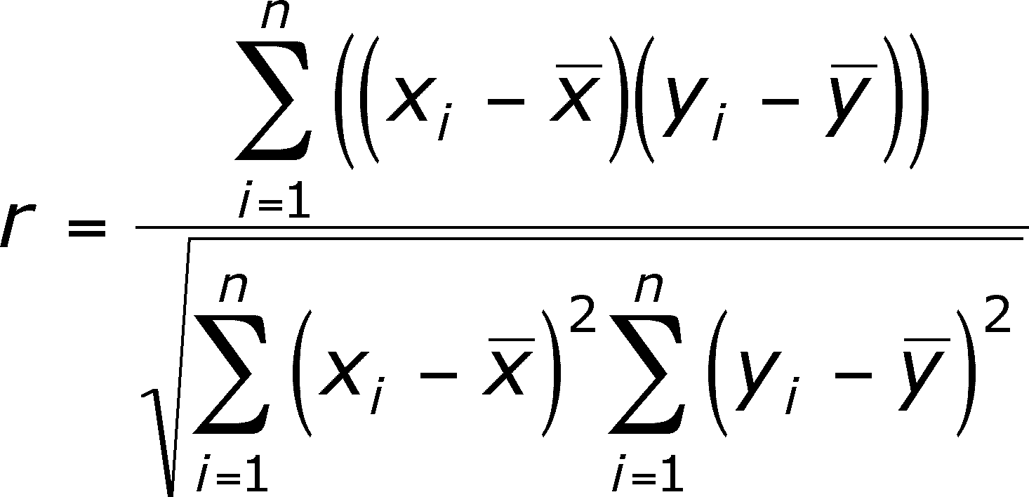
We can quantify how strong the linear relationship is by calculating a correlation coefficient. The formula is: It is easier to let technology do the calculation!

Slide 12
We can quantify how strong the linear relationship is by calculating a correlation coefficient. It is easier to let technology do the calculation! You have multiple options:
Calculator
Minitab
Excel
Websites

Slide 13
Calculation example Correlation Coefficient = -0.492 Correlation Coefficient is abbreviated by r. r = -0.492
x y
5 7
2 6
3 8
6 4
5 5
4 6
2 6

Slide 14
TI Calculator: Type x data into L₁ and y data into L₂ then go to VARS -> Statistics -> EQ -> r r = -0.492 Note: it does not matter which is the x data and which is the y data for computing r.
x y
5 7
2 6
3 8
6 4
5 5
4 6
2 6

Slide 15
Consider the following data:
x y
2 14
14 10
57 28
14 16
23 16
56 18
8 1
r = - 0.734
r = 0.538
r = 0.734
r = 0.466
r = - 0.538

Slide 16
Consider the following data:
x1 x2
0 -4
8 -6
7 -8
9 -9
5 -5
8 -8
8 -7
6 -9
r = - 0.034
r = - 0.724
r = - 0.545
r = - 0.983
r = - 0.241

Slide 17
Properties of the Correlation Coefficient
$−1≤r≤1$
If $r<0$ then there is a negative relationship between the two variables
If $r>0$ then there is a positive relationship between the two variables
r only measures a linear relationship
The greater $\left|r\right|$, the stronger the relationship

Slide 18
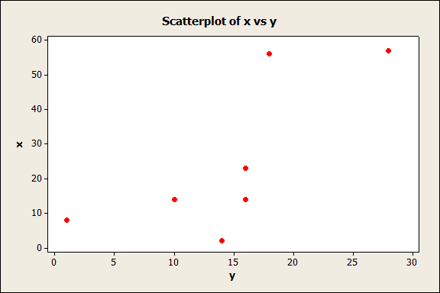
The correlation coefficient is 0.734 There is a positive relationship
x y
2 14
14 10
57 28
14 16
23 16
56 18
8 1

Slide 19
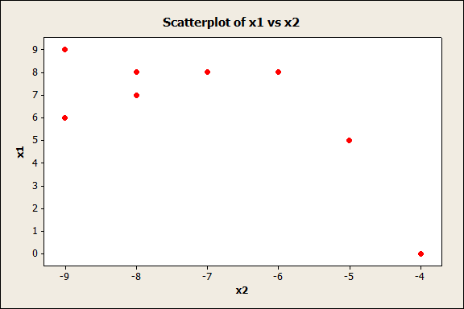
The correlation coefficient is - 0.724 There is a negative relationship
x1 x2
0 -4
8 -6
7 -8
9 -9
5 -5
8 -8
8 -7
6 -9

Slide 20
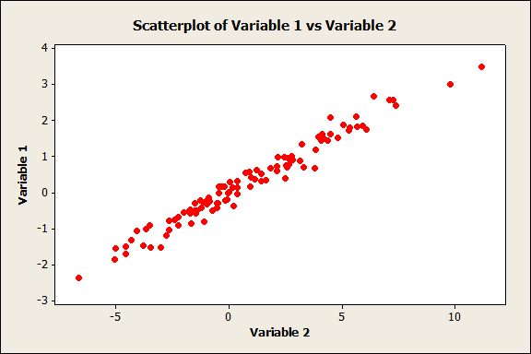
Guess the correlation
r = - 0.821
r = - 0.759
r = 0.388
r = 0.674
r = 0.983
r = 0.983

Slide 21
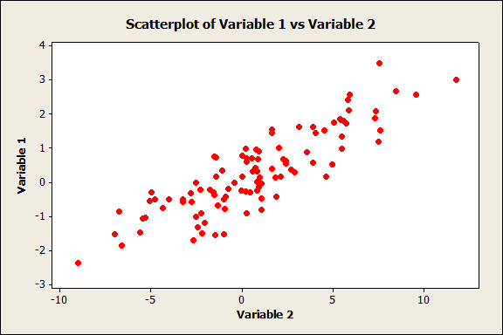
Guess the correlation
r = 0.121
r = 0.372
r = 0.644
r = 0.865
r = 0.978
r = 0.865

Slide 22
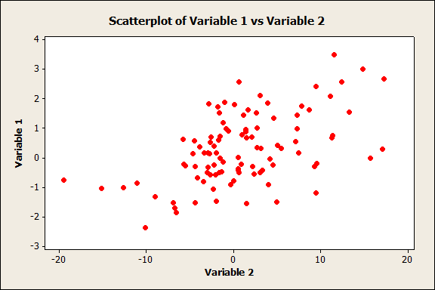
Guess the correlation
r = 0.372
r = 0.522
r = 0.644
r = 0.865
r = 0.978
r = 0.522

Slide 23
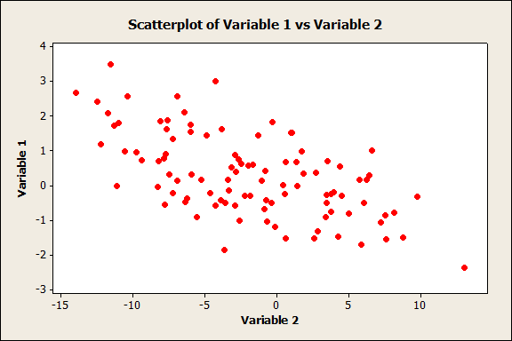
Guess the correlation
r = - 0.034
r = - 0.299
r = - 0.438
r = - 0.601
r = - 0.894
r = - 0.601

Slide 24
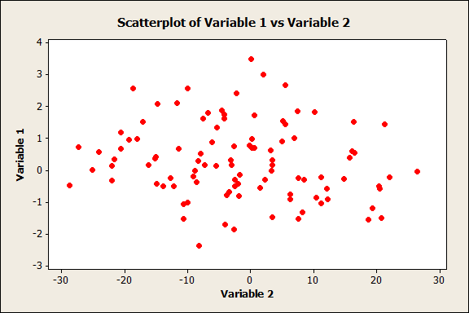
Guess the correlation
r = - 0.004
r = - 0.156
r = - 0.441
r = - 0.699
r = - 0.923
r = - 0.156

Slide 25
Guess the correlation
r = 0.7484
r = 0.3156
r = 0.0116
r = - 0.2994
r = - 0.6235
r = 0.0116

Slide 26
Guess the correlation
r = 0.7484
r = 0.2676
r = 0.0018
r = - 0.1944
r = - 0.7588
r = 0.0018

Slide 27
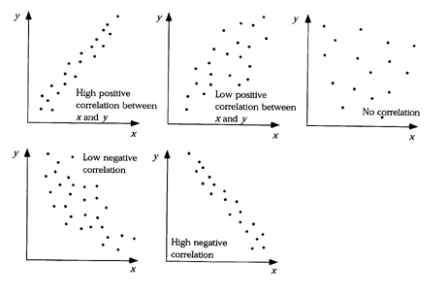

Slide 28
Fill in the blank: If one variable tends to increase linearly as the other variable increases, the variables are __________ correlated.
Positively
Negatively
Not

Slide 29
Fill in the blank: If one variable tends to increase linearly as the other variable decreases, the variables are __________ correlated.
Positively
Negatively
Not

Slide 30
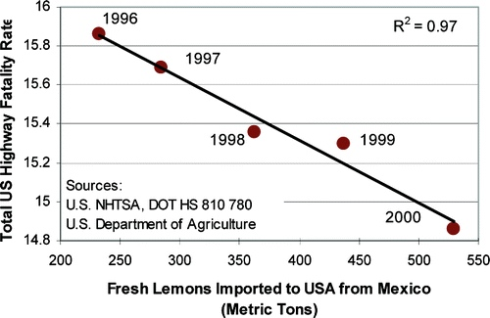
If there is a correlation (relationship) between two variables, it does not necessarily mean there is a causal relationship between the two variables (one variable affects the other).

Slide 31
If there is a correlation (relationship) between two variables, it does not necessarily mean there is a causal relationship between the two variables (one variable affects the other)

Slide 32
Nobel Prize and McDonalds data set
Country | Nobel Prize Count | McDonalds Count
Austria | 11 | 148
Czech Republic | 2 | 60
Denmark | 13 | 99
Finland | 2 | 93
Greece | 2 | 48
Hungary | 3 | 76
Iceland | 1 | 3
Ireland | 5 | 62
Luxembourg | 0 | 6
Norway | 8 | 55
Portugal | 2 | 91
Slovakia | 2 | 10
Turkey | 0 | 133
United States | 270 | 12804
The correlation coefficient of this data set is closest to what value?
-0.999
0.999
0.099
-0.099

Slide 33
The correlation between the number of Nobel Prizes awarded and number of McDonald’s Restaurants for select countries is strong. Therefore, we can correctly conclude that if a country were to build more McDonald’s Restaurants its inhabitants would be more likely to receive Nobel Prizes.
Country | Nobel Prize Count | McDonalds Count
Austria | 11 | 148
Czech Republic | 2 | 60
Denmark | 13 | 99
Finland | 2 | 93
Greece | 2 | 48
Hungary | 3 | 76
Iceland | 1 | 3
Ireland | 5 | 62
Luxembourg | 0 | 6
Norway | 8 | 55
Portugal | 2 | 91
Slovakia | 2 | 10
Turkey | 0 | 133
United States | 270 | 12804
True
False

Slide 34
Nobel Prize and McDonalds data set
Country | Nobel Prize Count | McDonalds Count
Austria | 11 | 148
Czech Republic | 2 | 60
Denmark | 13 | 99
Finland | 2 | 93
Greece | 2 | 48
Hungary | 3 | 76
Iceland | 1 | 3
Ireland | 5 | 62
Luxembourg | 0 | 6
Norway | 8 | 55
Portugal | 2 | 91
Slovakia | 2 | 10
Turkey | 0 | 133
United States | 270 | 12804
A confounding variable is a variable that is not accounted for that can affect both variables being studied.

Slide 35
Recall the equation of a line is: $y=mx+b$ where m is the slope of the line and b is the y intercept. In statistics we use this notation: $y=β_{o}+β_{1}x$ where $β_{1}$ is the slope and $β_{o}$ is the y intercept. The values of $β_{1}$ and $β_{o}$ are unknown and must be estimated from the data.

Slide 36
The values of $β_{1}$ and $β_{o}$ are unknown and estimated using a method called “least squares.” This method picks the line that minimizes the sum of the squared errors of all the data points. What is an error?

Slide 37
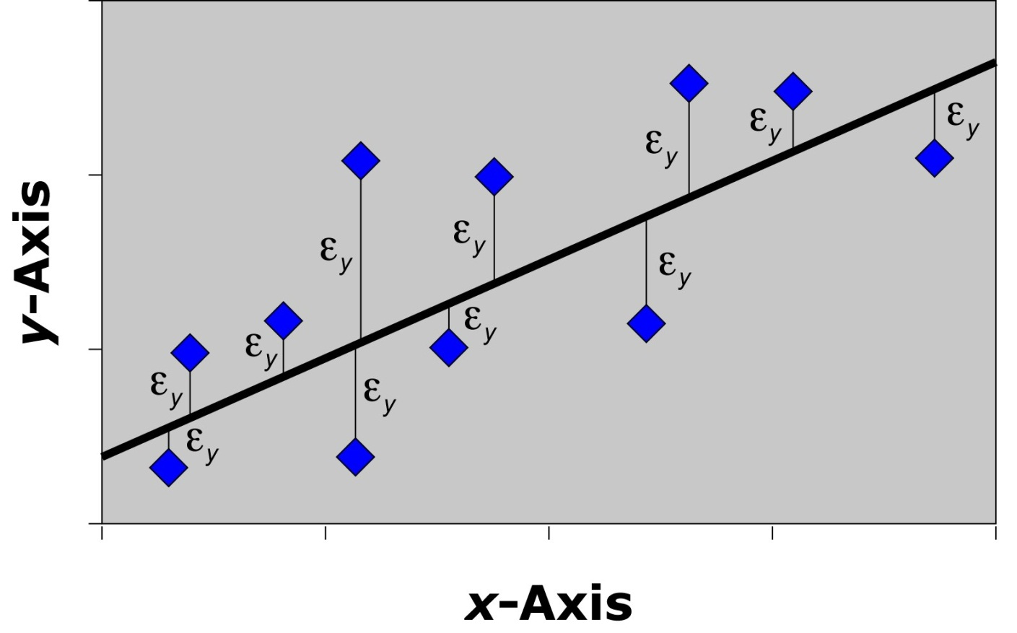
An error is the vertical distance between a data point and the line and is abbreviated as ε

Slide 38
The method of least squares picks the line that results in this being the smallest: $ε_{1}+ε_{2}+ε_{3}+⋯+ε_{n}$.

Slide 39
We will let computes calculated the line of best fit or the least squares line because it requires multivariate calculus.

Slide 40
The regression line below is a poor fit of the data and results in high error.

Slide 41
The regression line below is a better fit of the data and results in lower error.

Slide 42
The regression line below is the line of best fit or the least squares line.

Slide 43
Review of properties of a line! Consider: $y=12+2.4x$ where x measures time in hours and y measures distance in miles. The interpretation if the slope is?
An increase of 1 hour results in an increase of 2.4 miles.
A decrease of 1 hour results in an increase of 2.4 miles.
A decrease of 2.4 miles results in a decrease of 1 mile.
An increase of 2.4 miles results in a decrease of 1 mile.

Slide 44
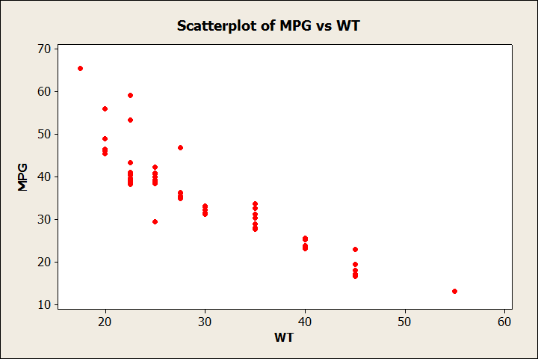
A study looked at the weight (in hundreds of pounds) and mpg of 82 vehicles. Following is the scatter plot:

Slide 45
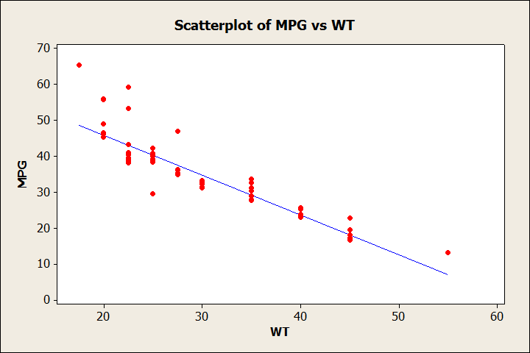
The line of best fit is: MPG = 68.2 - 1.11 Weight

Slide 46
The line of best fit is: MPG = 68.2 - 1.11 Weight. What does the slope tell us?
An increase in mpg of 1 results in an increase in weight of 111 pounds.
A decrease in mpg of 1 results in an increase in weight of 111 pounds.
An increase in weight of 100 pounds results in a decrease in gas mileage of 1.11 mpg.
An increase in weight of 100 pounds results in an increase in gas mileage of 1.11 mpg.

Slide 47
The line of best fit is: MPG = 68.2 - 1.11 Weight. What does the y-intercept tell us?
A car with a weight of 0 lbs gets 68.2 mpg
A car with a weight of 100 lbs gets 68.2 mpg
A car with a weight of 1000 lbs gets 68.2 mpg
A car with a weight of 2000 lbs gets a 68.2 mpg

Slide 48
Consider the following data set and graph. The graph is of this data.
X | Y
6 | 5
2 | 7
7 | 5
3 | 6
6 | 3
7 | 8
4 | 4
7 | 4
True
False

Slide 49
A direct relationship means an increase in one variable results in an increase in the other. This is also a positive correlation An inverse relationship means an increase in one variable results in a decrease in the other. This is also a negative correlation

Slide 50
There is a negative correlation between the two variables which indicates a direct relationship between femur length and horse height.
There is a positive correlation between the two variables which indicates an inverse relationship between femur length and horse height.
There is a negative relationship between the two variables which indicates an inverse relationship between femur length and horse height.
There is a positive relationship between the two variables which indicates a direct relationship between femur length and horse height.
None of the above

