Slide 1
Welcome to the Wonderful World of Clickers
Please answer the following to the best of your ability
I am a female
I am a male

Slide 2
Statistics Is?
The study of variability
The science of data
Statistics is the study of the collection, organization, analysis, and interpretation of data
Some math topic

Slide 3
Ron Paul received 8% of the vote in the Republican primary in New Hampshire in 2008 and 24% in 2012. The media today reported that he tripled his support.
True
False
Neither true nor false, but depends.

Slide 4
A study of people going to night-clubs first determines that there are about 250-300 people that go to a club of interest. A sample size of 30 is selected, giving an interval of 300/30 = 10. A random number between 1 and 10 is generated and comes up with 7. Starting with the 7th person to enter the club, every 10th person is given a brief interview. Other precautions are taken to neutralize any impact on the study of what time of night people enter the club.
This is a simple random sample
This is not a simple random sample

Slide 5
Suppose farmer Bob wishes to work out the average milk yield of his herd which consists of Ayrshire, Friesian, Galloway and Jersey cows. He divides up his herd into the four sub-groups based on breed and take a sample from each breed based on how many of that breed are in his herd.
This is a simple random sample
This is not a simple random sample

Slide 6
The following are all quantitative variables (opposed to qualitative variables): Age Sex IQ Weight
True
False

Slide 7
The following are all discrete variables (opposed to continuous variables): Number of students in class today Number of legs my cat has Number of attempts I need to make one free throw Mass of my cat
True
False

Slide 8
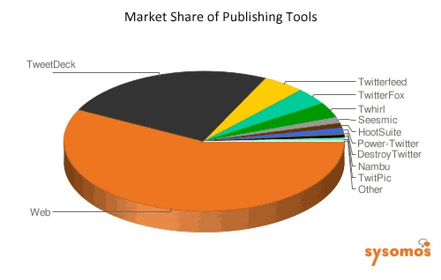
What is wrong with this pie chart?
Too many categories
Don’t know how big categories are
Three Dimensional appearance
Does not start at 12:00
Nothing is wrong!

Slide 9
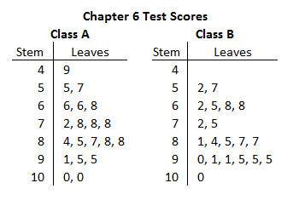
This is an example of side-by-side stem-and-leaf plots. True or False: One student in Class A scored 91%
True
False

Slide 10
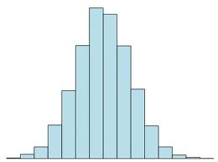
This histogram is:
Symmetric
Skewed left
Skewed right
Bimodal
Unimodal

Slide 11
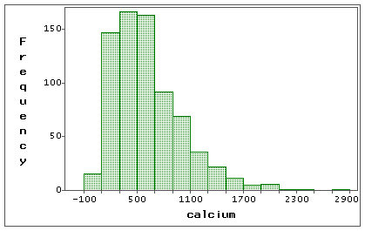
This histogram is:
Symmetric
Skewed left
Skewed right
Bimodal
Unimodal

Slide 12
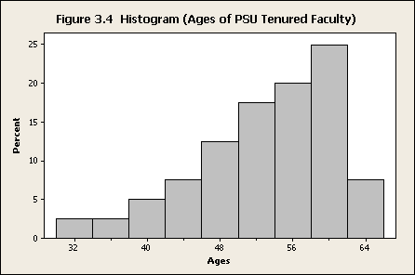
This histogram is:
Symmetric
Skewed left
Skewed right
Bimodal
Unimodal

Slide 13
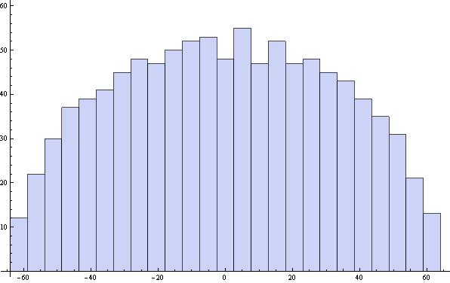
This histogram is:
Symmetric
Skewed left
Skewed right
Bimodal
Unimodal

Slide 14
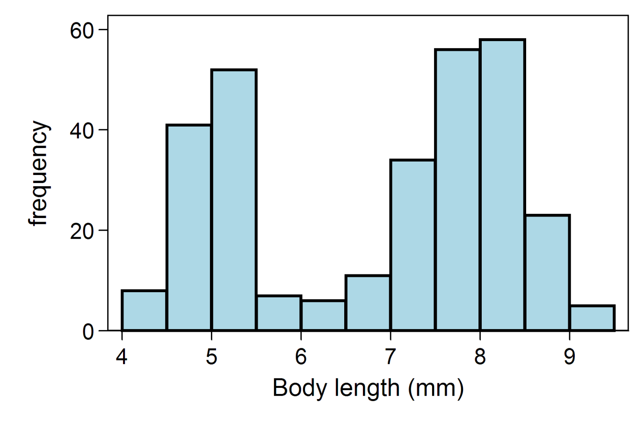
This histogram is:
Symmetric
Skewed left
Skewed right
Bimodal
Unimodal

Slide 15
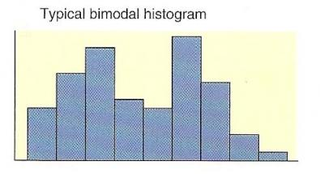
This histogram is:
Symmetric
Skewed left
Skewed right
Bimodal
Unimodal

Slide 16
The distances traveled (in miles) to 7 different swim meets are given as: 16, 43, 35, 25, 62, 88, 70. Find the median distance traveled.
35 miles
25 miles
43 miles
62 miles
88 miles

Slide 17
For a data set with an even number of observations, half of the observations are always greater than the ________.
Median
Mean
Mode
Harmonic mean
Range

Slide 18
What is the relationship among the mean, median and mode in every symmetric distribution?
They are all equal
The mean equals the median
The mean equals the mode
The median equals the mode
They are all different

Slide 19
A question in a survey asks for an assisted living home resident’s favorite color. Which measure of central location is most appropriate to summarize this question?
Median
Mode
Mean
Range
Standard deviation

Slide 20
Which measures of central location are not strongly affected by extremely small or extremely large values?
Mean and median
Mean and mode
Mode and median
Mean, median, and mode

Slide 21
In a unimodal distribution that is skewed left the median is typically greater than the mean.
True
False

Slide 22
In a unimodal distribution that is skewed right the median is typically less than the mean.
True
False

Slide 23
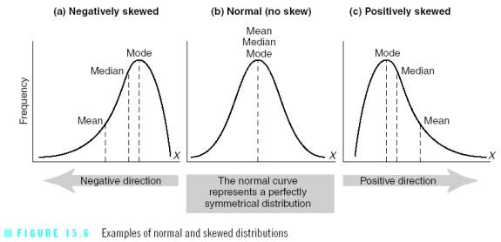
The mean, median, and mode and how they relate to skewness.

Slide 24
What is the range of this sample of data: 0, 5, -40, 20, 35?
35
40
75
80
5

Slide 25
What is the standard deviation of this sample of data: 0, 5, -40, 20, 35?
25.179
75.000
28.151
27.500
5.0000

Slide 26
What are the 1st, 2nd, and 3rd quartiles of this data set, respectively?
64, 68, 72
64, 68.3, 71
66, 68.3, 73
66, 67, 68
66, 68.5, 71
Heights
70
68
64
69
72
66
66
67
71
71

Slide 27
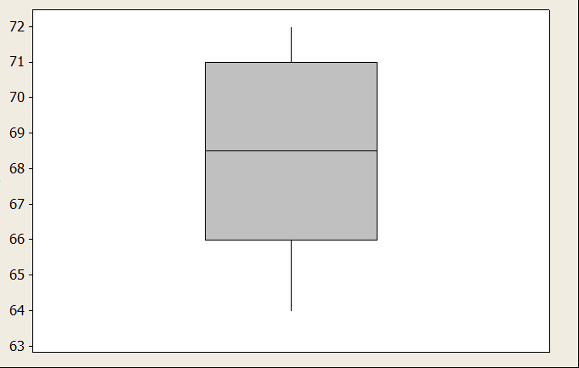
What kind of graph is this?
Histogram
Dot plot
Box plot
Bar chart
Pie chart

Slide 28
What is the added height value of 85 called? (How do we know?)
Really tall person
Outlier
Minimum
Interquartile Range
90th percentile
Heights
70
68
64
69
72
66
66
67
71
71
85

Slide 29
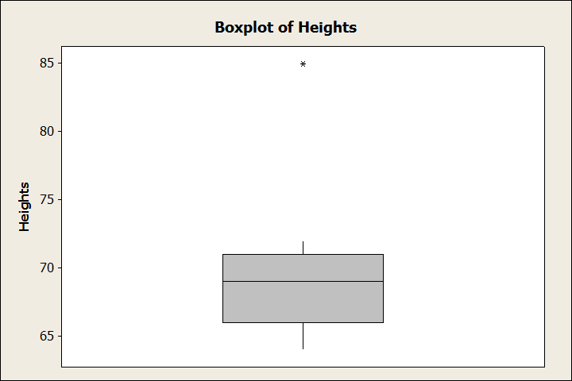
Boxplot with outlier marker.
Heights
70
68
64
69
72
66
66
67
71
71
85

Slide 30
Terri received a score of 92% on her chemistry exam and a score of 88% on her biology exam. In the chemistry class the mean was 80% and the standard deviation was 6%. In the biology class the mean was 80% and the standard deviation was 3%. In which class did she do better compared to her peers?
Chemistry Class
Biology Class
Same in both classes
Not enough information

