Slide 1
Chapter 9 – Hypothesis Tests concerning One Population Mean

Slide 2
Hypothesis testing is basic to the scientific method and statistical theory gives us a way of conducting tests of scientific hypotheses.

Slide 3
Scientific philosophy today rests on the idea of falsification: For a theory to be a valid scientific theory it must be possible, at least in principle, to make observations that would prove the theory false.

Slide 4
Scientific theories are usually made up of many hypotheses and the hypotheses are often tested individually, not the theory as a whole.

Slide 5
For example, here is a simple hypothesis: All swans are white

Slide 6
Hypothesis: All swans are white This is a valid scientific hypothesis because there is a way to falsify it: I can observe one black swan and the hypothesis would fall. For more information on the history and philosophy of falsification read Karl Popper.

Slide 7
Besides the idea of falsification, we must keep in mind the other basic tenant of the scientific method: All evidence that supports or falsifies a theory or hypothesis must be empirically based and reproducible.

Slide 8
In other words, data! Just holding a belief (no matter how firm) that a theory or hypothesis is true or false is not a scientifically justifiable stance.

Slide 9
Hypothesis testing in statistics has an underlying assumption that is similar in nature to how our (U.S.) legal system is set up. In our legal system, a person is assumed innocent (hypothesis) unless the evidence (data) shows otherwise.

Slide 10
In hypothesis testing, the hypothesis under investigation is assumed true and then is examined in light of the data. We use statistical methods to make a decision on the validity of the hypothesis.

Slide 11
Example Lets assume a hypothesis under consideration is: The mean height of males in the U.S. is 70 inches.

Slide 12
The mean height of males in the U.S. is 70 inches is called the Null Hypothesis and is the hypothesis we assume true to start with but may be nullified (falsified) given empirical evidence.

Slide 13
The mean height of males in the U.S. is 70 inches is called the Null Hypothesis. It is called the null hypothesis because we are collecting data to see if the data nullifies or falsifies it.

Slide 14
Null Hypothesis: The mean height of males in the U.S. is 70 inches If the data does not falsify the null hypothesis then we go on believing the null hypothesis is true. If the data does falsify the null hypothesis then we have to stop believing the truth of the null hypothesis in favor of an alternative hypothesis.

Slide 15
Null Hypothesis: The mean height of males in the U.S. is 70 inches Usually alternative hypotheses are more general than the null hypothesis.

Slide 16
Null Hypothesis: The mean height of males in the U.S. is 70 inches For this example, our alternative hypothesis is: The mean height of males in the U.S. is not 70 inches.

Slide 17
Special notation has been developed for expressing a null and alternative hypothesis concerning a population mean and for our example it is: $H_{o}: μ=70 inches$ (null hypothesis) $H_{a}: μ≠70 inches$ (alternative hypothesis)

Slide 18
State the null and alternative hypotheses to be tested
Decide upon a level of significance for the test
Collect data
Compute a test statistic and determine the p-value of the hypothesis test
Make a decision
Interpret the decision in terminology appropriate for the scientific field in which the test was conducted

Slide 19
Step 1: State the null and alternative hypotheses to be tested
The null and alternative hypotheses to be tested need to be decided upon first then the testing steps follow. Too often researchers get caught up in the “research” and do not take the time to clearly articulate what it is that they want to test.

Slide 20
Step 2: Decide upon a level of significance for the test
A significance level is a way for an experimenter to decide upon the level of evidence necessary to reject the validity of the null hypothesis.

Slide 21
Step 2: Decide upon a level of significance for the test
In a court of law, this concept is captured verbally as “beyond a reasonable doubt.” May doubt still exist? Yes, but the threshold is beyond what is considered reasonable or probable.

Slide 22
Step 2: Decide upon a level of significance for the test
Significance in statistical hypothesis testing is expressed as an alpha (Greek letter α) level. An alpha level of α = 0.05 is typical in most sciences although an alpha level of α = 0.10 is commonly used in sciences with studies where the data often has large (and unexplained) variability such as in sociological and psychological studies. How to use the significance level will be discussed in Step 5.

Slide 23
Step 3: Collect data
This could be the basis for a course in itself. A study, experiment, survey, etc… is conducted and data is gathered. The quality of data and subsequent reliability of the hypothesis test depends on the quality of the way the data was generated!

Slide 24
Step 4: Compute a test statistic and determine the p-value of the hypothesis test
There are particular formulae for different types of hypotheses tests and once the experimenter determines the type of test they are conducting they can choose the appropriate formula.

Slide 25
Step 4: Compute a test statistic and determine the p-value of the hypothesis test
The formulaic computations result in a value called the test statistic. This value captures the information necessary to make a decision.

Slide 26
Step 4: Compute a test statistic and determine the p-value of the hypothesis test
Once the test statistic has been computed, the p-value of the hypothesis test can be obtained from the test statistic.
I recommend you use technology to compute test statistics. While you can compute test statistics by hand, it is cumbersome and it is possible to make errors.

Slide 27
Step 5: Make a decision
There are only two decisions an experimenter can make based on the hypothesis test theory presented in this course.
Fail to reject the validity of the null hypothesis.
Reject the validity of the null hypothesis in favor of the alternative hypothesis.

Slide 28
Step 5: Make a decision
The criterion for making a decision is easy, based on the p-value, and always the same:
If p-value > α then: Fail to reject the validity of the null hypothesis.
If p-value ≤ α then: Reject the validity of the null hypothesis in favor of the alternative hypothesis.

Slide 29
Step 6: Interpret the decision in terminology appropriate for the scientific field in which the test was conducted
In the classroom, this step is often forgotten or poorly done, but is very critical!

Slide 30
Step 6: Interpret the decision in terminology appropriate for the scientific field in which the test was conducted
The experimenter must always remember that they have specialized training and understanding of the research problem and they must describe the results of an hypothesis test in terms that the audience of the results can understand.

Slide 31
Step 6: Interpret the decision in terminology appropriate for the scientific field in which the test was conducted
The way the experimenter describes the results depends on the audience which may range in scientific sophistication from lay person to scientific colleague.

Slide 32
Step 6: Interpret the decision in terminology appropriate for the scientific field in which the test was conducted
The experimenter must always keep the audience in mind when explaining the results and the burden of understanding lies with the experimenter.

Slide 33
Example
Step 1: State the null and alternative hypotheses to be tested
$H_{o}: μ=70 inches$ (null hypothesis) $H_{a}: μ≠70 inches$ (alternative hypothesis) Null Hypothesis: The mean height of males in the U.S. is 70 inches Alternative hypothesis is: The mean height of males in the U.S. is not 70 inches.

Slide 34
Example
Without formally going through each step, what if a simple random sample of heights of 6 males is collected and the data are: 62, 63, 62, 60, 61, 64
Which hypothesis is supported by this sample of data?
$H_{o}: μ=70 inches$ (null hypothesis) $H_{a}: μ≠70 inches$ (alternative hypothesis)

Slide 35
Example
What if a simple random sample of heights of 6 males is collected and the data are: 69, 70, 71, 70, 69, 69
Which hypothesis is supported by this sample of data?
$H_{o}: μ=70 inches$ (null hypothesis) $H_{a}: μ≠70 inches$ (alternative hypothesis)

Slide 36
Example
What if a simple random sample of heights of 6 males is collected and the data are: 70, 71, 70, 72, 71, 71
Which hypothesis is supported by this sample of data?
$H_{o}: μ=70 inches$ (null hypothesis) $H_{a}: μ≠70 inches$ (alternative hypothesis)

Slide 37
Lets formally go through the steps
Step 1: State the null and alternative hypotheses to be tested
$$H_{o}: μ=70 inches$$
$$H_{a}: μ≠70 inches$$

Slide 38
Step 2: Decide upon a level of significance for the test
The most commonly chosen value is $α=0.05$ or a 5% significance level.
The most common confidence level for a confidence interval is 95%
Coincidence?! I think not.

Slide 39
Step 3: Collect data
The basic type of sample needed is a simple random sample. Lets pretend we took a simple random sample of size n = 6 males in the U.S. -> 70, 71, 70, 72, 71, 71.

Slide 40
Step 4: Compute a test statistic and determine the p-value of the hypothesis test
The formula for the test statistic for a one-sample t test for one population mean is: $Test Statistic= \frac{\overline{x}−μ_{o}}{s/{\sqrt{n}}}$

Slide 41
Step 4: Compute a test statistic and determine the p-value of the hypothesis test
$$Test Statistic= \frac{\overline{x}−μ_{o}}{s/{\sqrt{n}}}$$
$$\overline{x}=70.833$$
$$s=0.753$$
$$n=6$$
$$μ_{o}=70$$
$$TS=2.712$$

Slide 42
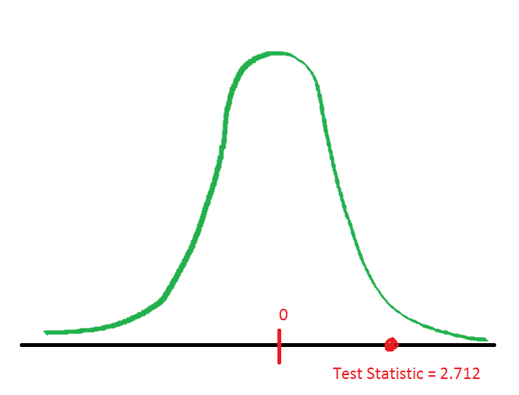
Step 4: Computing the p-value – use the t distribution

Slide 43
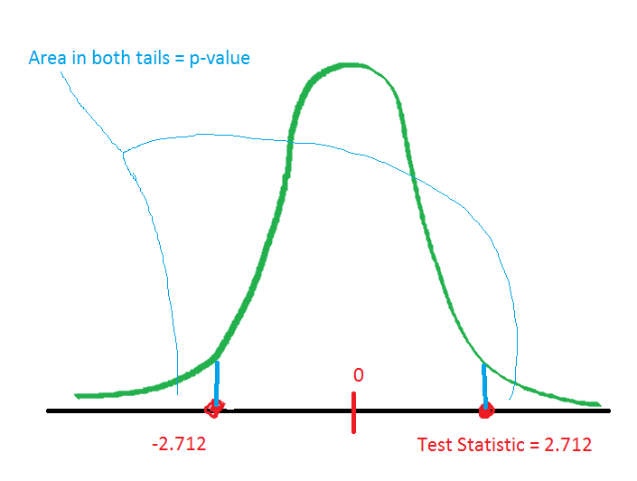
Step 4: Computing the p-value – use technology!

Slide 44
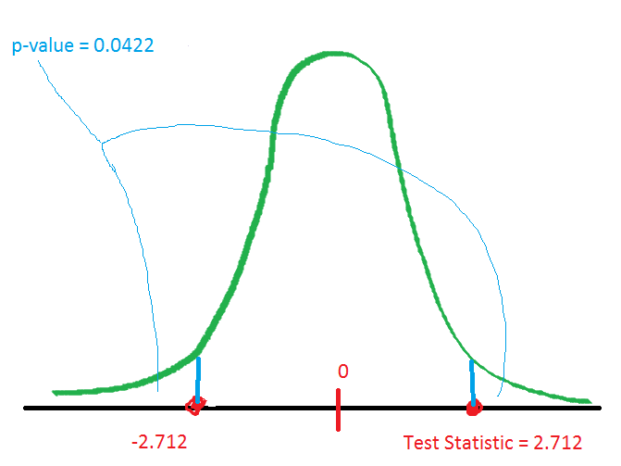
Step 4: Computing the p-value – use technology!

Slide 45
Step 5: Make a decision
If p-value > α then: Fail to reject the validity of the null hypothesis.
If p-value ≤ α then: Reject the validity of the null hypothesis in favor of the alternative hypothesis.
For our example, p-value = 0.0422 and $α=0.05$

Slide 46
Step 5: decision is “Reject the validity of the null hypothesis in favor of the alternative hypothesis”

Slide 47
Step 6: Interpret the decision in terminology appropriate for the scientific field in which the test was conducted
Reject the validity of the null hypothesis in favor of the alternative hypothesis
$H_{o}: μ=70 inches$ (null hypothesis) $H_{a}: μ≠70 inches$ (alternative hypothesis)

Slide 48
Step 6: Reject the validity of the null hypothesis in favor of the alternative hypothesis
$H_{o}: μ=70 inches$ (null hypothesis) $H_{a}: μ≠70 inches$ (alternative hypothesis)
Based on the sample of data there is statistical evidence that the mean height of all men in the U.S. is not 70 inches. In fact, the data suggest the mean height is greater than 70 inches.

Slide 49
Deciding upon a null and alternative hypothesis
The null hypothesis is usually the “neutral” or equality situation.
The alternative hypothesis is usually the hypothesis of scientific interest.

Slide 50
Deciding upon a null and alternative hypothesis
A hypothesis test is to be performed to decide whether adult females under the age of 51 are, on average, getting less than the RDA of 18 mg of iron. What is the null hypothesis is?
$H_{o}: μ=18 mg$
$H_{o}: μ>18 mg$
$H_{o}: μ<18 mg$
$H_{o}: μ≠18 mg$

Slide 51
Deciding upon a null and alternative hypothesis
A hypothesis test is to be performed to decide whether adult females under the age of 51 are, on average, getting less than the RDA of 18 mg of iron. What is the alternative hypothesis is?
$H_{a}: μ=18 mg$
$H_{a}: μ>18 mg$
$H_{a}: μ<18 mg$
$H_{a}: μ≠18 mg$

Slide 52
A hypothesis test is to be performed to decide whether the mean annual salary of classroom teachers in Hawaii is less than the national mean which is $45,900. What is the null hypothesis?
$H_{o}: μ=$ $45,900
$H_{o}: μ>\text{\$45,900}$
$H_{o}: μ<$ $45,900
$H_{o}: μ≠\text{\$45,900}$

Slide 53
A hypothesis test is to be performed to decide whether the mean annual salary of classroom teachers in Hawaii is less than the national mean which is $45,900. What is the alternative hypothesis?
$H_{a}: μ=$ $45,900
$H_{a}: μ>\text{\$45,900}$
$H_{a}: μ<$ $45,900
$H_{a}: μ≠\text{\$45,900}$

Slide 54
A company that produces snack foods uses a machine to package 454 g bags of pretzels. The company wishes to conduct a hypothesis test to see if the machine is not working properly. What are the appropriate null and alternative hypotheses?
$H_{o}: μ>$ 454 g and$H_{a}: μ=$ 454 g
$H_{o}: μ≠$ 454 g and$H_{a}: μ=$ 454 g
$H_{o}: μ=$ 454 g and$H_{a}: μ≠$ 454 g
$H_{o}: μ=$ 454 g and$H_{a}: μ>$ 454 g
$H_{o}: μ=$ 454 g and$H_{a}: μ<$ 454 g

Slide 55
The Czech government recommends at most 0.5 ppm Cadmium in dry vegetables. You harvest a bunch of wild mushrooms and know they contain some Cd. You want to conduct a hypothesis test to see if the mean Cd level of the mushrooms is greater than the government recommendation. What are the correct hypotheses?
$H_{o}: μ>$ 0.5 ppm and$H_{a}: μ=$ 0.5 ppm
$H_{o}: μ≠$ 0.5 ppm and$H_{a}: μ=$ 0.5 ppm
$H_{o}: μ=$ 0.5 ppm and$H_{a}: μ≠$ 0.5 ppm
$H_{o}: μ=$ 0.5 ppm and$H_{a}: μ>$ 0.5 ppm
$H_{o}: μ=$ 0.5 ppm and$H_{a}: μ<$ 0.5 ppm

Slide 56
According to historical research, the average American watched 4.66 hours of TV per day in 2002. Researchers are interested in whether Americans this year watch, on average, less TV per day than in 2002. What are the correct hypotheses to be tested?
$H_{o}: μ>$ 4.66 and$H_{a}: μ=$ 4.66
$H_{o}: μ≠$ 4.66 and$H_{a}: μ=$ 4.66
$H_{o}: μ=$ 4.66 and$H_{a}: μ≠$ 4.66
$H_{o}: μ=$ 4.66 and$H_{a}: μ>$ 4.66
$H_{o}: μ=$ 4.66 and$H_{a}: μ<$ 4.66

Slide 57
Researchers are interested in whether Americans this year watch, on average, less TV per day than in 2002 and are testing these hypotheses: $H_{o}: μ=$ 4.66 and$H_{a}: μ<$ 4.66. They took a random sample of size n = 20 people and found $\overline{x}=4.835$ and $s=2.291$. What is the p-value?
0.632
0.736
0.368
0.634
0.733

Slide 58
Researchers are interested in whether Americans this year watch, on average, less TV per day than in 2002 and are testing these hypotheses: $H_{o}: μ=$ 4.66 and$H_{a}: μ<$ 4.66. They took a random sample of size n = 20 people and found $\overline{x}=4.835$ and $s=2.291$. The p-value is 0.632. What should they conclude given $α=0.05$?
The data does not support the null hypothesis
The data supports the null hypothesis
The data supports the alternative hypothesis
The data fails to support the null hypothesis
The data supports neither the null nor the alternative hypotheses

Slide 59
Researchers are interested in whether Americans this year watch, on average, less TV per day than in 2002 and are testing these hypotheses: $H_{o}: μ=$ 4.66 and$H_{a}: μ<$ 4.66. They took a random sample of size n = 20 people and found $\overline{x}=4.835$ and $s=2.291$. The p-value is 0.0.632 which means the data supports the null hypothesis. Therefore, in lay terms…
Americans watch more TV this year compared to 2002
Americans watch less TV this year compared to 2002
Americans watch the same amount of TV this year compared to 2002

Slide 60
A hypothesis test is performed to decide whether adult females under the age of 51 are, on average, getting less than the RDA of 18 mg of iron where $H_{o}: μ=$ 18 and$H_{a}: μ<$ 18. They took a random sample of size n = 45 people and found $\overline{x}=$14.68 and $s=$4.2. What is the p-value?
0.00000353
0.00000176
0.99999824
0.00000011
0.000000057

Slide 61
A hypothesis test is to be performed to decide whether adult females under the age of 51 are, on average, getting less than the RDA of 18 mg of iron where $H_{o}: μ=$ 18 and$H_{a}: μ<$ 18. They took a random sample of size n = 45 people and found $\overline{x}=$14.68 and $s=$4.2. The p-value is $1.76×{10}^{−6}$? What should they conclude given $α=0.05$?
The data supports the null hypothesis
The data supports the alternative hypothesis
The data fails to support the alternative hypothesis
The data supports neither the null nor the alternative hypotheses

Slide 62
A hypothesis test is to be performed to decide whether adult females under the age of 51 are, on average, getting less than the RDA of 18 mg of iron where $H_{o}: μ=$ 18 and$H_{a}: μ<$ 18. They took a random sample of size n = 45 people and found the p-value is $1.76×{10}^{−6}$ which means the data supports the alternative hypothesis. Therefore, in lay terms…
Adults females are getting their RDA of iron
Adult females are getting less than their RDA of iron
Adult females are getting more than their RDA of iron

Slide 63
According to historical research, the average American ate 30 lbs of cheese in 2001. Researchers are interested in whether Americans this year eat, on average, more cheese than in 2001. What are the correct hypotheses to be tested?
$H_{o}: μ>$ 30 and$H_{a}: μ=$ 30
$H_{o}: μ≠$ 30 and$H_{a}: μ=$ 30
$H_{o}: μ=$ 30 and$H_{a}: μ≠$ 30
$H_{o}: μ=$ 30 and$H_{a}: μ>$ 30
$H_{o}: μ=$ 30 and$H_{a}: μ<$ 30

Slide 64
Researchers are interested in whether Americans this year eat, on average, more cheese than in 2001 and are testing these hypotheses: $H_{o}: μ=$ 30 lbs and$H_{a}: μ>$ 30 lbs. They took a random sample of size n = 35 people and found $\overline{x}=31.7$ and $s=6.9$. What is the p-value?
0.1541
0.9229
0.0725
0.1450
0.0771

Slide 65
Researchers are interested in whether Americans this year eat, on average, more cheese than in 2001 and are testing these hypotheses: $H_{o}: μ=$ 30 lbs and$H_{a}: μ>$ 30 lbs. They took a random sample of size n = 35 people and found $\overline{x}=31.7$ and $s=6.9$. The p-value is 0.0771. What should they conclude given $α=0.05$?
Fail to reject the validity of the null hypothesis
Reject the validity of the null hypothesis
Nobody really knows what is in Craft Singles

Slide 66
Researchers are interested in whether Americans this year eat, on average, more cheese than in 2001 and are testing these hypotheses: $H_{o}: μ=$ 30 lbs and$H_{a}: μ>$ 30 lbs. They took a random sample of size n = 35 people and found $\overline{x}=31.7$ and $s=6.9$. The p-value is 0.0771. What should they conclude given $α=0.10$?
Fail to reject the validity of the null hypothesis
Reject the validity of the null hypothesis
Nobody really knows what is in Craft Singles

Slide 67
$H_{o}: μ=$ 30 lbs and$H_{a}: μ>$ 30 lbs. They took a random sample of size n = 35 people and found $\overline{x}=31.7$ and $s=6.9$. The p-value is 0.0771.
For $α=0.10$we reject the validity of the null hypothesis
For $α=0.05$we fail to reject the validity of the null hypothesis

