Slide 1
Chapter 8 – Hypothesis Tests concerning One Population Mean

Slide 2
Two different conclusions based on different $α$ values.
Who picks $α$?
What is $α$?

Slide 3
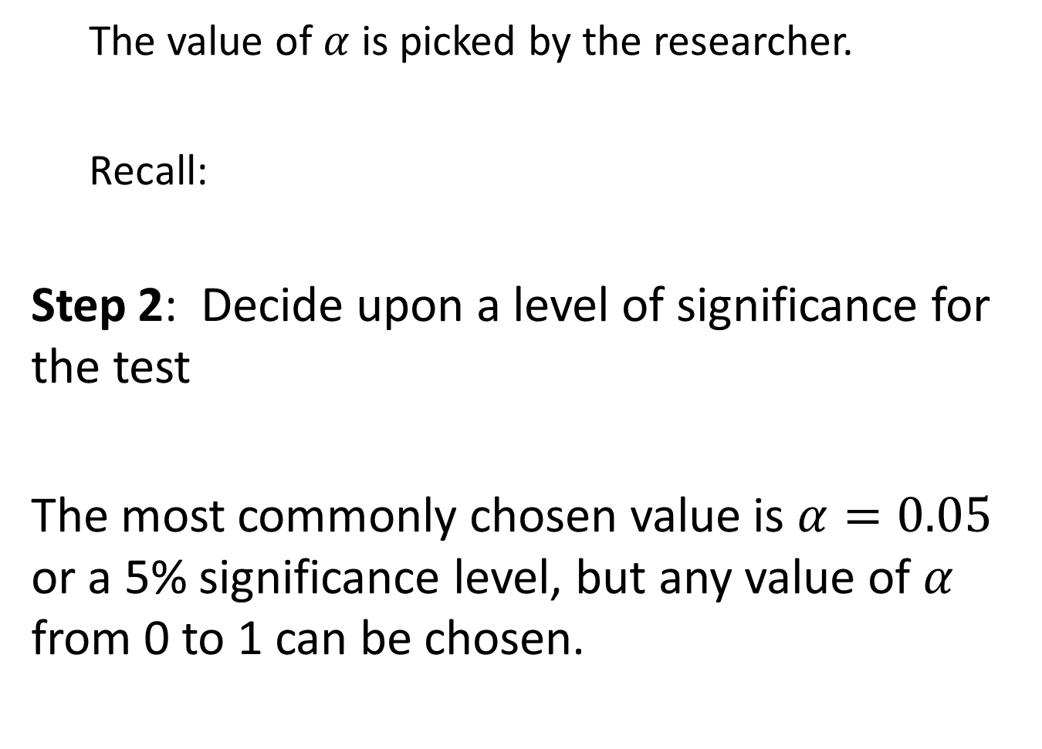
The value of $α$ is picked by the researcher.
Recall:
Step 2: Decide upon a level of significance for the test
The most commonly chosen value is $α=0.05$ or a 5% significance level, but any value of $α$ from 0 to 1 can be chosen.

Slide 4
Types of Error
There are two types of error associated with an hypothesis test. Consider the hypothesis test:
$H_{o}:$ Person is innocent $H_{a}:$Person is guilty

Slide 5
$H_{o}:$ Person is innocent $H_{a}:$Person is guilty
Trial occurs and jury renders a verdict (decision)
If verdict is innocent and person really is innocent then correct decision
If verdict is guilty and person really is guilty then correct decision

Slide 6
$H_{o}:$ Person is innocent $H_{a}:$Person is guilty
What types of incorrect decisions or ERRORS can be made?

Slide 7
$H_{o}:$ Person is innocent $H_{a}:$Person is guilty
Guilty person declared innocent – set free
Innocent person convicted – fried

Slide 8
$H_{o}:$ Person is innocent $H_{a}:$Person is guilty

Slide 9
$H_{o}:$ Person is innocent $H_{a}:$Person is guilty

Slide 10
A Type I error is defined as the experimenter rejecting the validity of the null hypothesis even though it is true.
A Type II error is defined as the experimenter failing to reject the validity of the null hypothesis even though it is false.

Slide 11
When an experimenter conducts a hypothesis test and chooses an alpha level (which is usually chosen to be α = 0.05) they are choosing the size of the Type I error.
In other words, Type I error = α.

Slide 12
Type II error cannot be chosen explicitly by the experimenter.

Slide 13
Type II error depends on the following things:
Choice of α level of the hypothesis test or Type I error.
The smaller an experimenter makes the Type I error, the greater the Type II error becomes and vise versa, the greater an experimenter makes the Type I error, the smaller the Type II error becomes.
This is unavoidable!

Slide 14
Type II error depends on the following things:
Sample size. The greater the sample size, the smaller the Type II error becomes.

Slide 15
Type II error depends on the following things:
Variability in the population being studied (abbreviated as σ, or the population standard deviation).
The greater the variability the greater the Type II error.

Slide 16
Assumption of the one-sample t hypothesis test in order for the decision to be valid:
The random sample came from a normal distribution
OR
The random sample size is $n≥30$

Slide 17
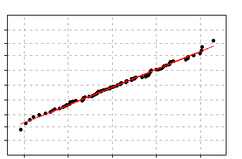
A researcher has a random sample of 18 and the normal probability plot is below. The t distribution assumption is met
True
False

Slide 18
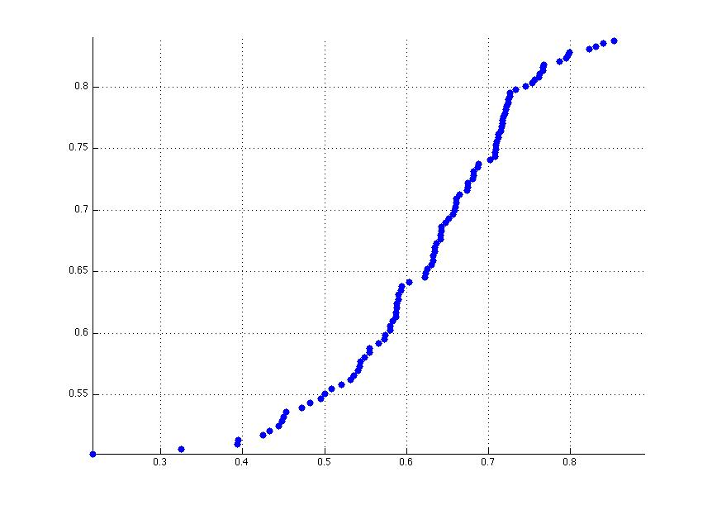
A researcher has a random sample of 4,232 and the normal probability plot is below. The t distribution assumption is met
True
False

