Slide 1
Chapter 7 – Confidence Intervals

Slide 2
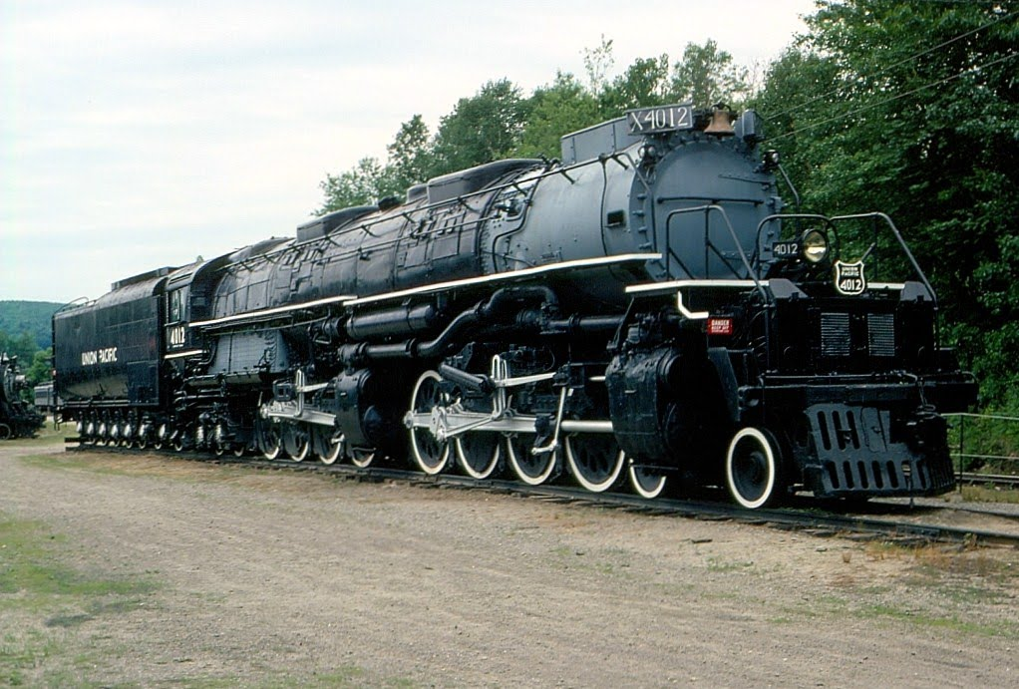

Slide 3
4-8-8-4 Union Pacific Big Boy weighs 762,000 lbs

Slide 4
All Confidence intervals we will study have this general form: $$Point Estimate ±Margin of Error$$

Slide 5
All Confidence intervals we will study have this general form: $$Point Estimate ±Margin of Error$$ For example, if the point estimate is 98.6 and the margin of error is 2 then the confidence interval is $98.6±2$ or $\left(96.6, 100.6\right)$

Slide 6
An experiment was conducted to study the extra amount of sleep people get by using a sleep aid drug. The confidence interval for the mean amount of extra sleep in hours is (2.4, 3.2). What is the point estimate for the mean amount of extra sleep?
2.4
2.6
2.8
3.0
3.2

Slide 7
An experiment was conducted to study the extra amount of sleep people get by using a sleep aid drug. The confidence interval for the mean amount of extra sleep in hours is (2.4, 3.2). Is there evidence the drug increased the average amount of sleep people got?
Yes
No
Maybe

Slide 8
An experiment was conducted to study the extra amount of sleep people get by using a sleep aid drug. The confidence interval for the mean amount of extra sleep in hours is $\left(−0.5, 1.5\right)$. Is there evidence the drug increased the average amount of sleep people got?
Yes
No
Maybe

Slide 9
An experiment was conducted to study the extra amount of sleep people get by using a sleep aid drug. The confidence interval for the mean amount of extra sleep in hours is $\left(−2.5, −0.5\right)$. Is there evidence the drug increased the average amount of sleep people got?
Yes
No
Maybe

Slide 10
An experiment was conducted to study the extra amount of sleep per night people get by using a sleep aid drug. The confidence interval for the mean amount of extra sleep in hours is (2.4, 3.2). This means that if I start taking this drug I should expect to get somewhere between 2.4 and 3.2 extra hours of sleep per night.
True
False

Slide 11
An experiment was conducted to study the extra amount of sleep per night people get by using a sleep aid drug. The confidence interval for the mean amount of extra sleep in hours is (2.4, 3.2). This means that if the average person starts taking this drug, they should expect to get somewhere between 2.4 and 3.2 extra hours of sleep per night.
True
False

Slide 12
An experiment was conducted to study the extra amount of sleep per night people get by using a sleep aid drug. The confidence interval for the mean amount of extra sleep in hours is (2.4, 3.2). Because the CI estimtes the mean amount of sleep, it is possible that if I took the drug, I could get zero hours of additional sleep per night.
True
False

Slide 13
$$Point Estimate ±Margin of Error$$ What is the margin of error? $$Margin of Error=Value from Distribution ∗Standard Error$$

Slide 14
$$Margin of Error=Value from Distribution ∗Standard Error$$ What is the standard error? $$Standard Error=estimate of standard deviation of point estimator$$

Slide 15
How do we use a sample of data to compute a confidence interval?
The t distribution interval:
$$\overline{x}±t_{\frac{α}{2},n−1}∗\frac{s}{\sqrt{n}}$$

Slide 16
Example: n = 8 randomly selected adults have their temperatures taken and the following data is recorded: 98.2, 98.8, 98.7, 98.8, 98.6, 98.7, 98.9, 98.6. Create a 95% confidence interval
The t distribution interval:$\overline{x}±t_{\frac{α}{2},n−1}∗\frac{s}{\sqrt{n}}$

Slide 17
$$\overline{x}=98.663 \\ s=0.213$$
The t distribution interval:$\overline{x}±t_{\frac{α}{2},n−1}∗\frac{s}{\sqrt{n}}$

Slide 18
$$\overline{x}=98.663 \\ s=0.213$$ Standard error: $\frac{s}{\sqrt{n}}=\frac{0.213}{\sqrt{8}}=0.0753$
The t distribution interval:$\overline{x}±t_{\frac{α}{2},n−1}∗\frac{s}{\sqrt{n}}$

Slide 19
$$\overline{x}=98.663 \\ s=0.213$$ Standard error: $\frac{s}{\sqrt{n}}=\frac{0.213}{\sqrt{8}}=0.0753$ Margin of error – need to use t table
The t distribution interval:$\overline{x}±t_{\frac{α}{2},n−1}∗\frac{s}{\sqrt{n}}$

Slide 20
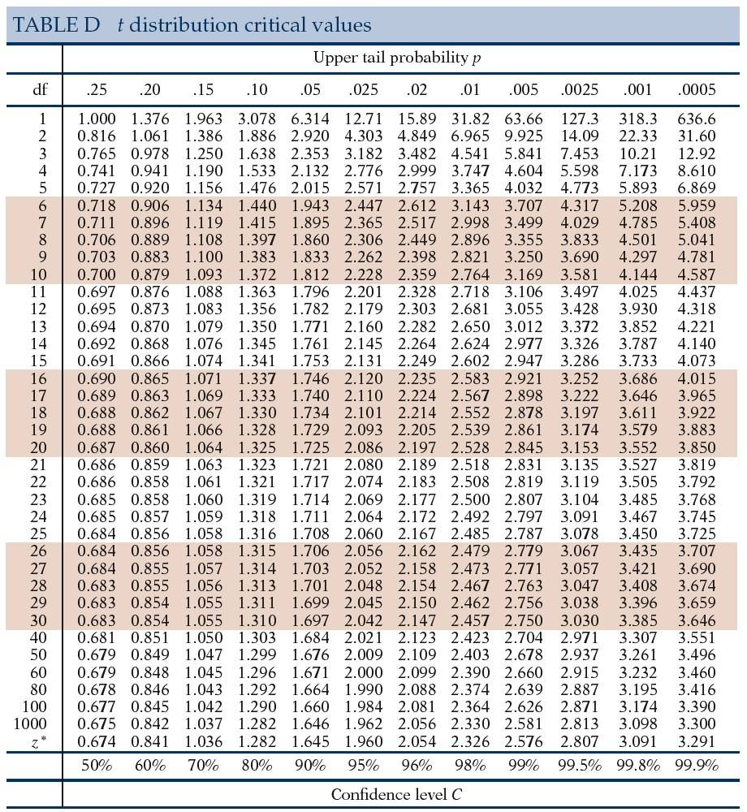
The t distribution interval:$\overline{x}±t_{\frac{α}{2},n−1}∗\frac{s}{\sqrt{n}}$

Slide 21
$t_{\frac{α}{2},n−1}$ = $t_{\frac{0.05}{2},8−1}=t_{0.025,7}=$2.365 Margin of error: $t_{\frac{α}{2},n−1}∗\frac{s}{\sqrt{n}}=\text{2.365}∗\frac{0.213}{\sqrt{8}}=0.1781$
The t distribution interval:$\overline{x}±t_{\frac{α}{2},n−1}∗\frac{s}{\sqrt{n}}$

Slide 22
95% Confidence interval: $98.663±0.1781$ $$\left(98.663−0.1781, 98.663+0.1781\right)=\left(98.485, 98.841\right)$$
The t distribution interval:$\overline{x}±t_{\frac{α}{2},n−1}∗\frac{s}{\sqrt{n}}$

Slide 23
What if we change the confidence level from 95% to 90%?
The t distribution interval:$\overline{x}±t_{\frac{α}{2},n−1}∗\frac{s}{\sqrt{n}}$

Slide 24
What if we change the confidence level from 95% to 90%? The only number that changes is $t_{\frac{α}{2},n−1}$
The t distribution interval:$\overline{x}±t_{\frac{α}{2},n−1}∗\frac{s}{\sqrt{n}}$

Slide 25
$t_{\frac{α}{2},n−1}$ = $t_{\frac{0.10}{2},8−1}=t_{0.05,7}=$1.895 Margin of error: $t_{\frac{α}{2},n−1}∗\frac{s}{\sqrt{n}}=\text{1.895}∗\frac{0.213}{\sqrt{8}}=0.1427$
The t distribution interval:$\overline{x}±t_{\frac{α}{2},n−1}∗\frac{s}{\sqrt{n}}$

Slide 26
90% Confidence interval: $98.663±0.1427$ $$\left(98.663−0.1427, 98.663+0.1427\right)=\left(98.520, 98.806\right)$$
The t distribution interval:$\overline{x}±t_{\frac{α}{2},n−1}∗\frac{s}{\sqrt{n}}$

Slide 27
What if we change the confidence level from 95% to 90%? 95% CI: $\left(98.485, 98.841\right)$ 90% CI: $\left(98.520, 98.806\right)$
The t distribution interval:$\overline{x}±t_{\frac{α}{2},n−1}∗\frac{s}{\sqrt{n}}$

Slide 28
An experiment was conducted to study the extra amount of sleep per night people get by using a sleep aid drug. The 95% confidence interval for the mean amount of extra sleep in hours is (2.4, 3.2).
There is a 95% chance that if I take this drug I will get between 2.4 and 3.2 additional hours of sleep.
We can be 95% confident that the mean amount of additional hours of sleep people get from using this drug is between 2.4 and 3.2 hours.
There is a 95% chance that any person taking this drug will get between 2.4 and 3.2 additional hours of sleep.

Slide 29
Construct a 90% confidence interval from the following information: $\overline{x}=25, n=36, \text{and} s=3.$ The interval is:
(23.985, 26.015)
(24.155, 25.845)
(24.020, 25.980)
(24.178, 25.822)

Slide 30
Construct a 98% confidence interval from the following information: $\overline{x}=100, n=56, \text{and} s=15.$ The interval is:
(95.98, 104.02)
(94.65, 105.35)
(95.20, 104.80)
(96.42, 103.58)

Slide 31
In 2011, Veronica Stevenson conducted research on the amount of TV watched per day in the U.S. She took a random sample of 40 people and found that $\overline{x}=4.615 \text{and} s=2.277.$ The 95% confidence interval for this sample is:
(3.887 hours, 5.343 hours)
(3.640 hours, 5.590 hours)
(4.008 hours, 5.222 hours)
(3.909 hours, 5.321 hours)

Slide 32
In 2011, Veronica Stevenson conducted research on the amount of TV watched per day in the U.S. She took a random sample of 40 people determined that the 95% CI is (3.887 hours, 5.343 hours) per day. Therefore, we can properly conclude:
95 out of 100 people watch between 3.887 and 5.343 hours of TV per day.
Every American watches at least 3.887 hours of TV per day.
It is likely the average American watches between 3.887 and 5.343 hours of TV per day.
No American watches more than 5.343 hours of TV per day.

Slide 33
In 2011, Veronica Stevenson conducted research on the amount of TV watched per day in the U.S. and determined that the 95% CI is (3.887 hours, 5.343 hours) per day. In 2000, the mean amount of TV watched per day in America was 4.47 hours per day. Therefore, we can reasonably conclude:
The mean amt. of TV watched in 2011 is less than that watched in 2000.
The mean amt. of TV watched in 2011 is more than that watched in 2000.
The mean amt. of TV watched in 2011 is the same as it was in 2000.

Slide 34
Assumption of the t interval method in order for the confidence level chosen to be valid:
The random sample came from a normal distribution
OR
The random sample size is $n≥30$

Slide 35
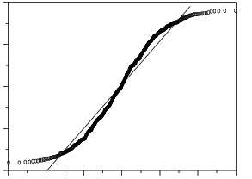
A researcher has a random sample of 112 and the normal probability plot is below. The t distribution assumption is met
True
False

Slide 36
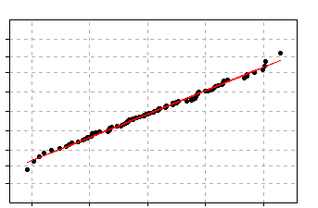
A researcher has a random sample of 18 and the normal probability plot is below. The t distribution assumption is met
True
False

Slide 37
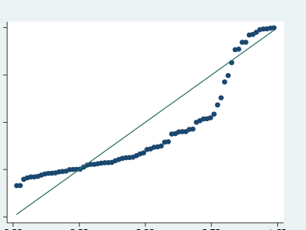
A researcher has a random sample of 29 and the normal probability plot is below. The t distribution assumption is met
True
False

Slide 38
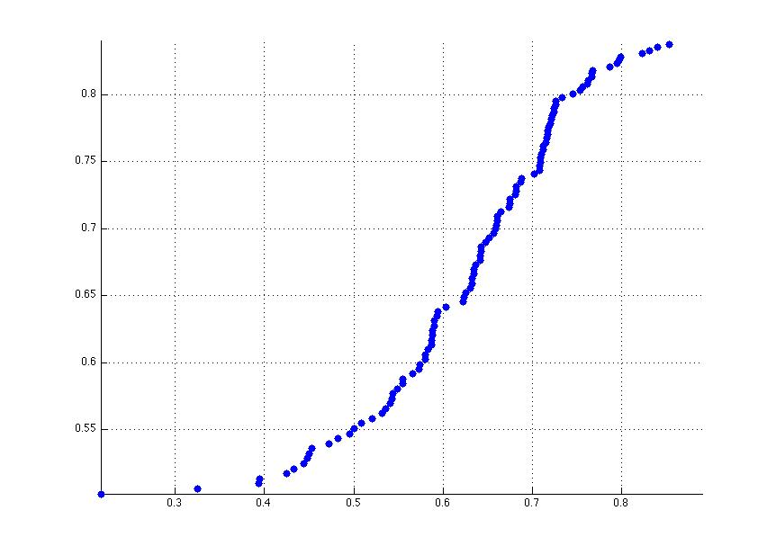
A researcher has a random sample of 4,232 and the normal probability plot is below. The t distribution assumption is met
True
False

Slide 39
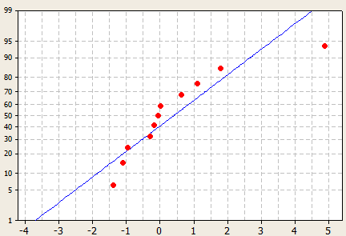
A researcher has a random sample of 11 and the normal probability plot is below. The t distribution assumption is met
True
False

Slide 40
The distribution of the annual incomes of a group of middle management employees approximates a normal distribution with a mean of $37,200 and a standard deviation of $800. About 68 percent of the incomes lie between what two incomes?
A. | $30,000 and $40,000
B. | $36,400 and $38,000
C. | $34,800 and $39,600
D. | $35,600 and $38,800

Slide 41
The previous question was a question about confidence intervals.
True
False

Slide 42
Fish and game wardens estimate the average weight of the fish or game population by using creel checks and other devices. Based on this sample data, a warden might estimate that the mean weight of Coho salmon caught in Lake Michigan is 2.5 pounds. This single number is called a point estimate of the unknown population parameter.
True
False

Slide 43
William S. Gosset, a brewmaster, developed the t test for the Guiness Brewery in Ireland, who published it in 1908 using the pen name "Student."
True
False

Slide 44
The margin of error can be determined if you know only the width of a confidence interval.
True
False

Slide 45
Increasing the margin of error decreases the width of a confidence interval.
True
False

Slide 46
Increasing the sample size decreases the width of a confidence interval.
True
False

Slide 47
Decreasing the confidence level decreases the width of a confidence interval.
True
False

Slide 48
The sample mean is used to estimate the population mean.
True
False

Slide 49
A confidence interval can be obtained if you know only the margin of error and the sample mean.
True
False

Slide 50
The margin of error depends on the confidence level of the confidence interval.
True
False

Slide 51
Values from a t distribution are based on degrees of freedom.
True
False

