Slide 1
Chapter 7 – Sampling Distributions

Slide 2
As sample size decreases, the sampling distribution of the sample mean becomes more normal regardless of the type of distribution being sampled from.
True
False

Slide 3
The population mean is used to estimate the sample mean.
True
False

Slide 4
Sampling error does not depend on sample size.
True
False

Slide 5
As sample size increases the variability (standard deviation) of the sampling distribution of the sample mean decreases.
True
False

Slide 6
For samples of size n, the mean of the sampling distribution of $\overline{x}$ equals the mean of the variable under consideration. In symbols: $μ_{\overline{x}}$ =$μ$.
True
False

Slide 7
For samples of size n, the standard deviation of the sampling distribution of $\overline{x}$ equals the standard deviation of the variable under consideration divided by the square root of the sample size. In symbols: $σ_{\overline{x}}=\frac{σ}{\sqrt{n}}$.
True
False

Slide 8
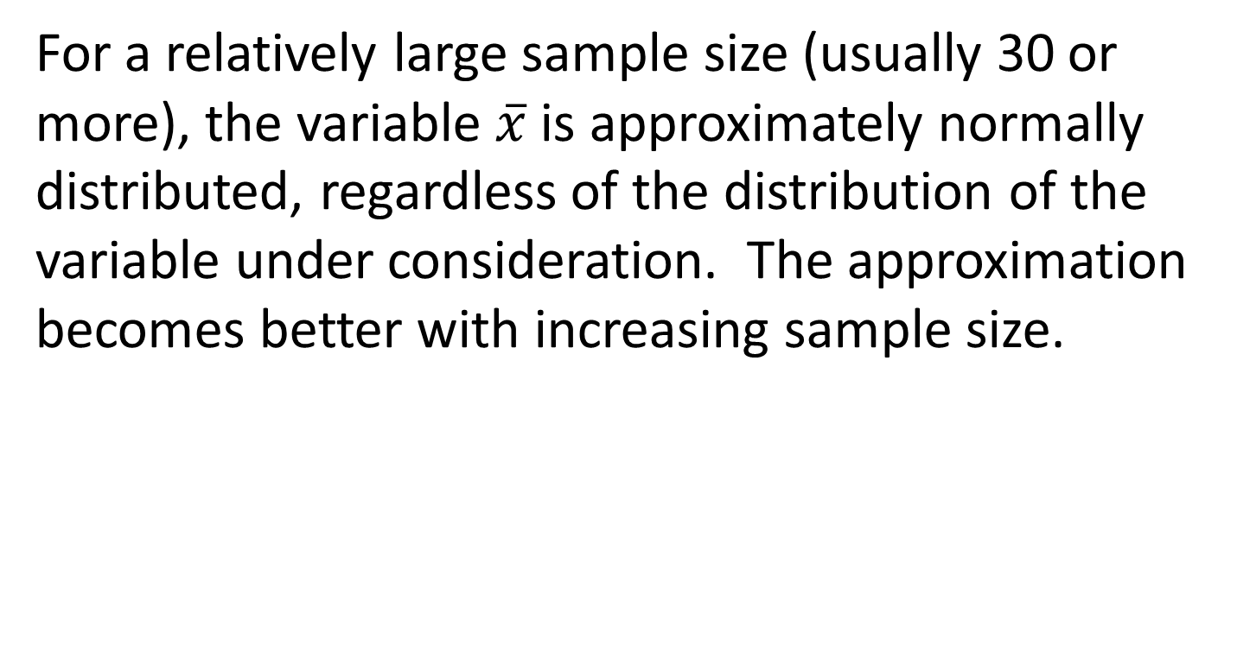
For a relatively large sample size (usually 30 or more), the variable $\overline{x}$ is approximately normally distributed, regardless of the distribution of the variable under consideration. The approximation becomes better with increasing sample size.
True
False

