Slide 1
Chapter 13 – The $Χ^{2}$ or Chi-Square Hypothesis Tests

Slide 2
How do we conduct a hypothesis test for questions like this: Does road rage tend to occur more often on certain days of the week than on others? First, we need to define road rage: “an incident in which an angry or impatient motorist or passenger intentionally injures or kills another motorist, passenger, or pedestrian, or attempts or threatens to injure or kill another motorist, passenger, or pedestrian.”

Slide 3
A study was conducted and the days on which 67 road rage incidents occurred. The data are:
Day | Frequency
Sunday | 5
Monday | 5
Tuesday | 9
Wednesday | 12
Thursday | 11
Friday | 18
Saturday | 7

Slide 4
A study was conducted and the days on which 67 road rage incidents occurred. The null and alternative hypotheses are: $H_{o}:$ Road rage incidents are uniformly distributed over every day of the week. $H_{a}:$ Road rage incidents are not uniformly distributed over every day of the week.

Slide 5
$H_{o}:$ Road rage incidents are uniformly distributed over every day of the week. This means if we have 67 road rage incidents there should be 67/7 = 9.57 each day of the week:
Sunday | Monday | Tuesday | Wednesday | Thursday | Friday | Saturday
9.57 | 9.57 | 9.57 | 9.57 | 9.57 | 9.57 | 9.57

Slide 6
$H_{o}:$ Road rage incidents are uniformly distributed over every day of the week. These values are the “expected frequencies” given the null hypothesis is true.
Sunday | Monday | Tuesday | Wednesday | Thursday | Friday | Saturday
9.57 | 9.57 | 9.57 | 9.57 | 9.57 | 9.57 | 9.57

Slide 7
Now, we compute the test statistic which is: $Test Statistic=\sum{\frac{{\left(Observed−Expected\right)}^{2}}{Expected}}$ $$TS=\frac{{\left(5−9.57\right)}^{2}}{9.57}+\frac{{\left(5−9.57\right)}^{2}}{9.57}+⋯+\frac{{\left(7−9.57\right)}^{2}}{9.57}=13.35$$
 | Sunday | Monday | Tuesday | Wednesday | Thursday | Friday | Saturday
Observed | 5 | 5 | 9 | 12 | 11 | 18 | 7
Expected | 9.57 | 9.57 | 9.57 | 9.57 | 9.57 | 9.57 | 9.57

Slide 8
The $TS=13.35$ and follows a $Χ^{2}$distribution. We need to find the critical value to make a decision. We need two things: • $α$ • Degrees of Freedom = $k−1$ For this problem, $α=0.05$ and $k−1=7−1=6$

Slide 9
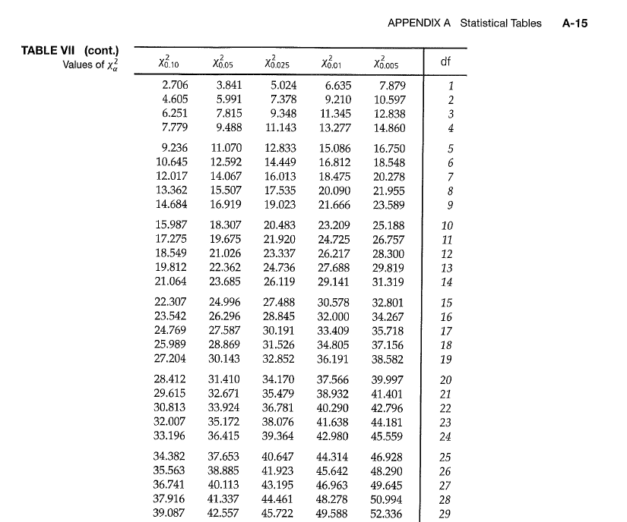

Slide 10
The critical value is 12.592. Decision rule for the $Χ^{2}$ test: • If the test statistic is less than the critical value then the data supports the null hypothesis • If the test statistic is equal to or greater than the critical value then the data supports the alternative hypothesis

Slide 11
The critical value is 12.592 and the test statistic is 13.35. So, our data supports the alternative hypothesis. • If the test statistic is less than the critical value then the data supports the null hypothesis • If the test statistic is equal to or greater than the critical value then the data supports the alternative hypothesis

Slide 12
The critical value is 12.592 and the test statistic is 13.35. So, our data supports the alternative hypothesis. $H_{o}:$ Road rage incidents are uniformly distributed over every day of the week. $H_{a}:$ Road rage incidents are not uniformly distributed over every day of the week.

Slide 13
$H_{o}:$ Road rage incidents are uniformly distributed over every day of the week. $H_{a}:$ Road rage incidents are not uniformly distributed over every day of the week.
Day | Frequency
Sunday | 5
Monday | 5
Tuesday | 9
Wednesday | 12
Thursday | 11
Friday | 18
Saturday | 7

Slide 14
Is a particular 6-sided die fair? I rolled a 6-sided die 300 times and got the following values:
Face | Frequency
1 | 42
2 | 55
3 | 38
4 | 57
5 | 64
6 | 44

Slide 15
Is a particular 6-sided die fair? I rolled a 6-sided die 300 times and got the following values:
$H_{o}:$ Die is fair $H_{a}:$ Die is biased in some way
Face | Frequency
1 | 42
2 | 55
3 | 38
4 | 57
5 | 64
6 | 44

Slide 16
Is a particular 6-sided die fair? I rolled a 6-sided die 300 times and got the following values:
$H_{o}:$ Die is fair $H_{a}:$ Die is biased in some way
Conduct the analysis. What do you conclude?
Face | Frequency
1 | 42
2 | 55
3 | 38
4 | 57
5 | 64
6 | 44

Slide 17
Is a particular 6-sided die fair? I rolled a 6-sided die 300 times and got the following values:
Face | Frequency | Expected Frequency
1 | 42 | 50
2 | 55 | 50
3 | 38 | 50
4 | 57 | 50
5 | 64 | 50
6 | 44 | 50
$H_{o}:$ Die is fair $H_{a}:$ Die is biased in some way
Conduct the analysis. What do you conclude?

Slide 18
$$Test Statistic=\sum{\frac{{\left(Observed−Expected\right)}^{2}}{Expected}}$$
Face | Frequency | Expected Frequency
1 | 42 | 50
2 | 55 | 50
3 | 38 | 50
4 | 57 | 50
5 | 64 | 50
6 | 44 | 50

Slide 19
$$Test Statistic=\sum{\frac{{\left(Observed−Expected\right)}^{2}}{Expected}}$$
Face | Frequency | Expected Frequency
1 | 42 | 50
2 | 55 | 50
3 | 38 | 50
4 | 57 | 50
5 | 64 | 50
6 | 44 | 50
I get test statistic = 10.28

Slide 20
The $TS=1$0.28. Now need to find the critical value. • $α$ • Degrees of Freedom = $k−1$ For this problem, $α=0.05$ and $k−1=6−1=$5

Slide 22
The critical value is 11.070. Decision rule for the $Χ^{2}$ test: • If the test statistic is less than the critical value then the data supports the null hypothesis • If the test statistic is equal to or greater than the critical value then the data supports the alternative hypothesis The test statistic is 10.28

Slide 23
The data supports the null.
$H_{o}:$ Die is fair $H_{a}:$ Die is biased in some way
Face | Frequency
1 | 42
2 | 55
3 | 38
4 | 57
5 | 64
6 | 44

Slide 24
A new casino game involves rolling 3 dice. The winnings are directly proportional to the total number of sixes rolled. Suppose a gambler plays the game 100 times, with the following observed counts: Number of Sixes Number of Rolls 0 48 1 34 2 15 3 3

Slide 25
The casino becomes suspicious of the gambler and wishes to determine whether the dice are fair. What do they conclude? Suppose a gambler plays the game 100 times, with the following observed counts: Number of Sixes Number of Rolls 0 48 1 34 2 15 3 3

Slide 26
The Chi Square test for contingency tables
$H_{o}:$ There is no association between two variables $H_{a}:$ There is an association between two variables

Slide 27
Parents of 66 children in kindergarten through 2nd grade were surveyed. Two social groups, middle and working, were identified. One of the questions dealt with the children’s knowledge of nursery rhymes.
$H_{o}:$ There is no association between two variables $H_{a}:$ There is an association between two variables
 | Nursery-Rhyme Knowledge
 |  | A Few | Some | Lots
Social | Middle | 4 | 13 | 15
Class | Working | 5 | 11 | 18

Slide 28
Parents of 66 children in kindergarten through 2nd grade were surveyed. Two social groups, middle and working, were identified. One of the questions dealt with the children’s knowledge of nursery rhymes.
$H_{o}:$ There is no association between two variables $H_{a}:$ There is an association between two variables
 | Nursery-Rhyme Knowledge |  |  |  | Column
 |  | A Few | Some | Lots | Total
Social | Middle | 4 | 13 | 15 | 32
Class | Working | 5 | 11 | 18 | 34
Row Total |  | 9 | 24 | 33 | 66

Slide 29
Observed
 | Nursery-Rhyme Knowledge |  |  |  | Column
 |  | A Few | Some | Lots | Total
Social | Middle | 4 | 13 | 15 | 32
Class | Working | 5 | 11 | 18 | 34
Row Total |  | 9 | 24 | 33 | 66
Expected
 | Nursery-Rhyme Knowledge |  |  |  | Column
 |  | A Few | Some | Lots | Total
Social | Middle | ? | ? | ? | 32
Class | Working | ? | ? | ? | 34
Row Total |  | 9 | 24 | 33 | 66

Slide 30
Expected
 | Nursery-Rhyme Knowledge |  |  |  | Column
 |  | A Few | Some | Lots | Total
Social | Middle | ? | ? | ? | 32
Class | Working | ? | ? | ? | 34
Row Total |  | 9 | 24 | 33 | 66
To find each expected cell value use the formula: (row total)*(column total)/grand total
For example, for the first cell the expected cell count would be 32*9/66 = 4.36

Slide 31
Expected
 | Nursery-Rhyme Knowledge |  |  |  | Column
 |  | A Few | Some | Lots | Total
Social | Middle | 4.36 | 11.64 | 16.00 | 32
Class | Working | 4.64 | 12.36 | 17.00 | 34
Row Total |  | 9 | 24 | 33 | 66
To find each expected cell value use the formula: (row total)*(column total)/grand total
For example, for the first cell the expected cell count would be 32*9/66 = 4.36

Slide 32
Observed
 | Nursery-Rhyme Knowledge |  |  |  | Column
 |  | A Few | Some | Lots | Total
Social | Middle | 4 | 13 | 15 | 32
Class | Working | 5 | 11 | 18 | 34
Row Total |  | 9 | 24 | 33 | 66
Expected
 | Nursery-Rhyme Knowledge |  |  |  | Column
 |  | A Few | Some | Lots | Total
Social | Middle | 4.36 | 11.64 | 16.00 | 32
Class | Working | 4.64 | 12.36 | 17.00 | 34
Row Total |  | 9 | 24 | 33 | 66

Slide 33
 | Nursery-Rhyme Knowledge |  |  |  | Column
 |  | A Few | Some | Lots | Total
Social | Middle | 4 | 13 | 15 | 32
Class | Working | 5 | 11 | 18 | 34
Row Total |  | 9 | 24 | 33 | 66
Observed
Expected
 | Nursery-Rhyme Knowledge |  |  |  | Column
 |  | A Few | Some | Lots | Total
Social | Middle | 4.36 | 11.64 | 16.00 | 32
Class | Working | 4.64 | 12.36 | 17.00 | 34
Row Total |  | 9 | 24 | 33 | 66
$$Test Statistic=\sum{\frac{{\left(Observed−Expected\right)}^{2}}{Expected}}$$

Slide 34
 | Nursery-Rhyme Knowledge |  |  |  | Column
 |  | A Few | Some | Lots | Total
Social | Middle | 4 | 13 | 15 | 32
Class | Working | 5 | 11 | 18 | 34
Row Total |  | 9 | 24 | 33 | 66
Observed
Expected
 | Nursery-Rhyme Knowledge |  |  |  | Column
 |  | A Few | Some | Lots | Total
Social | Middle | 4.36 | 11.64 | 16.00 | 32
Class | Working | 4.64 | 12.36 | 17.00 | 34
Row Total |  | 9 | 24 | 33 | 66
$$Test Statistic=\frac{{(4−4.36)}^{2}}{4.36}+⋯+\frac{{\left(18−17\right)}^{2}}{17}=0.4903$$

Slide 35
The $TS=0.4903$. Now need to find the critical value. • $α$ • Degrees of Freedom = $(r−1)(c−1)$ For this problem, $α=0.05$ and $\left(r−1\right)\left(c−1\right)=\left(2−1\right)\left(3−1\right)=1∗2=$2

Slide 37
The critical value is 5.991. Decision rule for the $Χ^{2}$ test: • If the test statistic is less than the critical value then the data supports the null hypothesis • If the test statistic is equal to or greater than the critical value then the data supports the alternative hypothesis The test statistic is 0.4903

Slide 38
The data supports the null hypothesis:
$H_{o}:$ There is no association between two variables $H_{a}:$ There is an association between two variables
 | Nursery-Rhyme Knowledge
 |  | A Few | Some | Lots
Social | Middle | 4 | 13 | 15
Class | Working | 5 | 11 | 18

Slide 39
Suppose you conducted a drug trial on a group of animals and you hypothesized that the animals receiving the drug would survive better than those that did not receive the drug. You conduct the study and collect the following data:
Ho: The survival of the animals is independent of drug treatment.
Ha: The survival of the animals is associated with drug treatment.

Slide 40
Ho: The survival of the animals is independent of drug treatment.
Ha: The survival of the animals is associated with drug treatment.
 | Dead | Alive | Total
Treated | 36 | 14 | 50
Not treated | 30 | 25 | 55
Total | 66 | 39 | 105

Slide 41
The survival of the animals is independent of drug treatment.
The survival of the animals is associated with drug treatment.
 | Dead | Alive | Total
Treated | 36 | 14 | 50
Not treated | 30 | 25 | 55
Total | 66 | 39 | 105

Slide 42
Is there a relationship between having AIDS and sexual preference of men? Thirty men were surveyed and the following hypotheses are to be examined:
Ho: There is no relationship between having AIDS and sexual preference of men
Ha: There is a relationship between having AIDS and sexual preference of men.

Slide 43
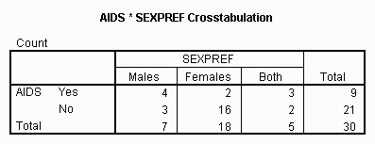
Ho: There is no relationship between having AIDS and sexual preference of men
Ha: There is a relationship between having AIDS and sexual preference of men.

Slide 44
There is no relationship between having AIDS and sexual preference of men
There is a relationship between having AIDS and sexual preference of men.

Slide 45
Is there a relationship between dining out and the sex of the individual? One hundred and ninety seven men and women were surveyed and the following hypotheses are to be examined:
Ho: There is no relationship between dining out habits and the sex of an individual
Ha: There is a relationship between dining out habits and the sex of an individual.

Slide 46
Ho: There is no relationship between dining out habits and the sex of an individual
Ha: There is a relationship between dining out habits and the sex of an individual.
 | Dining Out Per Week
 | Tree or more times | Twice | Once | Less than Once | Never
Men | 23 | 19 | 34 | 10 | 12
Women | 14 | 14 | 39 | 17 | 15

Slide 47
There is no relationship between dining out habits and the sex of an individual
There is a relationship between dining out habits and the sex of an individual.
 | Dining Out Per Week
 | Tree or more times | Twice | Once | Less than Once | Never
Men | 23 | 19 | 34 | 10 | 12
Women | 14 | 14 | 39 | 17 | 15

