Slide 1
Statistics and Mathematics through Data Collection and Graphical Display for the 2nd and 3rd Grades
Dr. Derek Webb
Bemidji State University

Slide 2
Citation Information
Article can be found at the Statistics Teacher Network website in issue 77: http://www.amstat.org/education/STN/
Talk can be found on my website: www.Faculty.bemidjistate.edu/dwebb

Slide 3
Impetus
Introduce students to statistical concepts and statistical thinking in K-5 grades
Simultaneously introduce new math concepts and reinforce ones already covered
Show the links between statistical thinking and scientific thinking
Use time series data

Slide 4
Alignment with Standards
This project is in alignment with the Minnesota State Standards content and pedagogy
http://education.state.mn.us/MDE/Academic_Excellence/Academic_Standards/Mathematics/index.html

Slide 5
Minnesota State Standards
Data Analysis – 3rd Grade (silent on grade 2)
Collect, organize, display, and interpret data. Use labels and a variety of scales and units in displays.
Collect, display and interpret data using frequency tables, bar graphs, picture graphs and number line plots having a variety of scales. Use appropriate titles, labels and units.

Slide 6
Alignment with Standards
National Council of Teachers of Mathematics Commission on Standards for School Mathematics. (1989). Curriculum and evaluation standards for school mathematics. Reston VA: The Council. http://www.nctm.org/standards/content.aspx?id=16909

Slide 7
National Council of Teachers of Mathematics
Pre-K–2 Expectations:
pose questions and gather data about themselves and their surroundings;
sort and classify objects according to their attributes and organize data about the objects;
represent data using concrete objects, pictures, and graphs.

Slide 8
National Council of Teachers of Mathematics
Grades 3–5 Expectations:
design investigations to address a question and consider how data-collection methods affect the nature of the data set;
collect data using observations, surveys, and experiments;
represent data using tables and graphs such as line plots, bar graphs, and line graphs;
recognize the differences in representing categorical and numerical data.

Slide 9
Alignment with Standards
This project is in alignment with the Common Core (CC) State Standards initiative – coordinated by the National Governor’s Association Center for Best Practices (NGA Center) and the Council of Chief State School Officers (CCSSO) (www.corestandards.org)
This project exceeds recommendations in CC for statistics

Slide 10
Common Core
Grade 2: Represent and interpret data.
Generate measurement data by measuring lengths of several objects to the nearest whole unit, or by making repeated measurements of the same object. Show the measurements by making a line plot, where the horizontal scale is marked off in whole-number units.
Draw a picture graph and a bar graph (with single-unit scale) to represent a data set with up to four categories. Solve simple put together, take-apart, and compare problems using information presented in a bar graph.

Slide 11
Common Core
Grade 3: Represent and interpret data.
Draw a scaled picture graph and a scaled bar graph to represent a data set with several categories. Solve one- and two-step “how many more” and “how many less” problems using information presented in scaled bar graphs. For example, draw a bar graph in which each square in the bar graph might represent 5 pets.
Generate measurement data by measuring lengths using rulers marked with halves and fourths of an inch. Show the data by making a line plot, where the horizontal scale is marked off in appropriate units—whole numbers, halves, or quarters.

Slide 12
Brief comment from ASA on Common Core
“The CC ignores the idea that statistical thinking needs to be nurtured and developed in a systematic way over time in the same way that mathematical thinking is developed. The use of data in the CC’s K-5 standards is there to support mathematical ideas and not to support statistical thinking.”
One response of an ASA team that reviewed the Common Core standards

Slide 13
Alignment with Standards
This project is in alignment with the American Statistical Association’s (ASA) Guidelines for the Assessment and instruction in Statistics Education (GAISE) Report: A pre-K-12 Curriculum Framework (2007) www.amstat.org/education/gaise/

Slide 14
Recommendations from GAISE
Underlying principle throughout the curriculum should be the use of the four-step statistical problem solving process:
(1) formulate a statistical question,
(2) collect data,
(3) analyze the data,
(4) interpret the results.

Slide 15
Pilot Project
Schoolcraft Learning Community 2nd and 3rd grade classes – about 55 students total.
An experiential based learning school located in northern Minnesota

Slide 16
Project Kickoff
I Visited each classroom and asked the students: “How does the outside temperature each morning change as we go through winter?”
Lots of student discussion followed…
Then I asked: “How can we find out?”

Slide 17
Project Overview
Students collect morning temperature each day for 30 days between 9 and 10 am.
During school-days temperature recorded at school with outdoor thermometer.
On weekends, students collect their own data and bring it to school on Monday

Slide 18
Project Overview
Second grade students make a time series graph of the data in degrees Fahrenheit.
Third grade students make two time series graphs – one in degrees Fahrenheit and one in degrees Celsius.

Slide 19
Project Overview
Why use both Fahrenheit and Celsius?
NCTM recommends students in all grades learn about the English (United States Customary System) as well as the Metric systems of measurement because the English system in the U.S. is not going away and the metric system is used by almost all of the rest of the world.

Slide 20
Project Overview
Why use both Fahrenheit and Celsius?
Having two graphs in different units side-by-side was useful in showing students that the general temperature trends and information conveyed in the graphs was the same regardless of the measurement system. This is a powerful property of graphs.

Slide 21
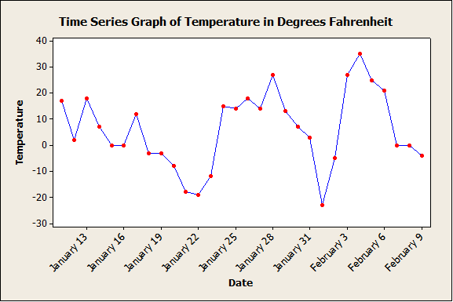
Example Graph

Slide 22
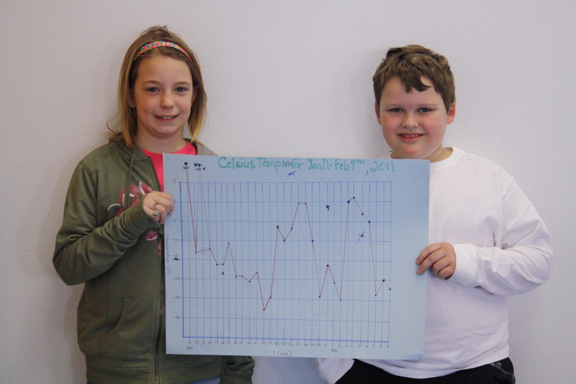
Actual Graphs

Slide 23
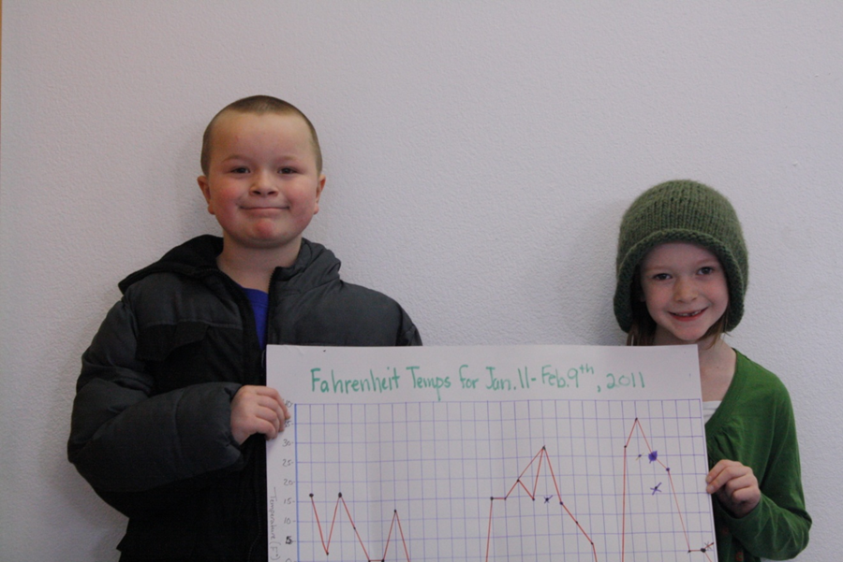
Actual Graphs

Slide 24
Graphs are Grade-Level Specific
Poster board graphs about 24 inches wide by 12 inches tall in each classroom
Axes and grid lines lightly drawn to assist the students with placement of each data point
The 2nd grade students had grid lines for each temperature degree, but the 3rd grade students had grid lines at 5 degree intervals.
This required 3rd grade students to estimate the placement of points down to the nearest degree which compliments other math skills appropriate for this grade level!

Slide 25
Weekend Fun!
“Homework” assigned each weekend – collect morning temperature each day.
How to collect data up to each student
Outside thermometer
Car thermometer
Radio
Television
Call Uncle Ed.

Slide 26
Weekend Problems!
Students back at school on Monday with different data – what to do?
Questions to consider:
Why is the data different?
Is one student correct and everybody else wrong?
How do we use all the data?

Slide 27
Weekend Data Solutions
2nd grade students use median to condense the information in all the data into one value to plot
3rd grade students use mean to condense the information in all the data into one value to plot
The median and mean have a practical use

Slide 28
Statistical Topic – The Range
Students learned about the range of a data set.
Computationally: maximum minus minimum.
Practically: distance
Students can find the range from counting degrees on the graph.
They don’t have to do subtraction with negative numbers if they are not ready to.

Slide 29
Math Topics
One big benefit to this statistical project is the connections to math topics.
Students learn statistics and mathematics in concert – not in silos.
The statistics is useful and interesting – not “just there” to do math calculations.

Slide 30
Math Topics – Cartesian Plane
Students are exposed to the Cartesian, or x, y coordinate system.
Don’t have to use the very abstract x, y axes labels - Can talk about the axes in terms of date and temperature.
Students get to plot points on the graph testing their understanding of the coordinate system!

Slide 31
Math Topics – Cartesian Plane
Students are graphing on a different part of the Cartesian plane. In math classes, most students only see:

Slide 32
Math Topics – Slope
Students were exposed to “slope of a line” using correct terminology to describe trends through time.
Example: the time series graph has a nearly constant trend from January 24 through January 27, a decreasing trend from January 28 through February 1, and an increasing trend from February 1 through February 5.

Slide 33
Math Topics – Tally Marks
After students collected 30 days of data, they created a tally table of the number of days at or below zero vs. the number of days above zero.
Other tally tables can be created and this gives students exposure to frequency tables.

Slide 34
Science!
Students introduced to a key idea behind the scientific method:
Use empirical evidence, DATA, to answer questions. Anecdotal evidence and personal beliefs don’t count

Slide 35
Science!
Good data collection and record keeping processes were used.
Data was collected during the same time interval every morning.
Data was recorded in one place every day.
At school, same thermometer was used every day.
Solution devised and followed for data collection on weekends.

Slide 36
Science!
Students learned about the scientific activity of taking data readings regularly through time.
This generates a type of data called longitudinal data.
Helps scientists learn about how a process changes through time and allows them to go back and study historical data.

Slide 37
Science!
Students compared the data they collected at Schoolcraft to data from different geographic locations such as Miami, FL; Minneapolis, MN; Chicago, IL; or Coos Bay, OR (using the internet).
Students also talked about the fact that at any given time, temperature is different at different geographical locations.

Slide 38
Science!
Students can also collect (journal) qualitative data (non-numerical data) every day, such as, cloudy, sunny, partly cloudy, and snowy.
Students could then examine the qualitative data for relationships with the quantitative temperature data.
The beginnings of scientific inquiry investigating associations!

Slide 39
Correct Terminology – NCTM Recommendation
Graph
Grid lines (those faint lines on the graph that allow students to easily graph data)
Axis labels
Date axis (x-axis)
Temperature axis (y-axis)
Trend and slope of a line
Increasing trend or positive slope
Decreasing trend or negative slope
Constant trend or constant slope

Slide 40
Correct Terminology – NCTM Recommendation
Maximum value of all the data
Minimum value of all the data
Range
Mean
Median
Sample
Data point – particular point on the graph
Data point coordinates

Slide 41
Why Time Series Data?
Easy to collect
Easy to graph
Can be incorporated into the curriculum early on
Commonly encountered data
Easy to link to science topics
For some reason it does not usually show up in most curricula

Slide 42
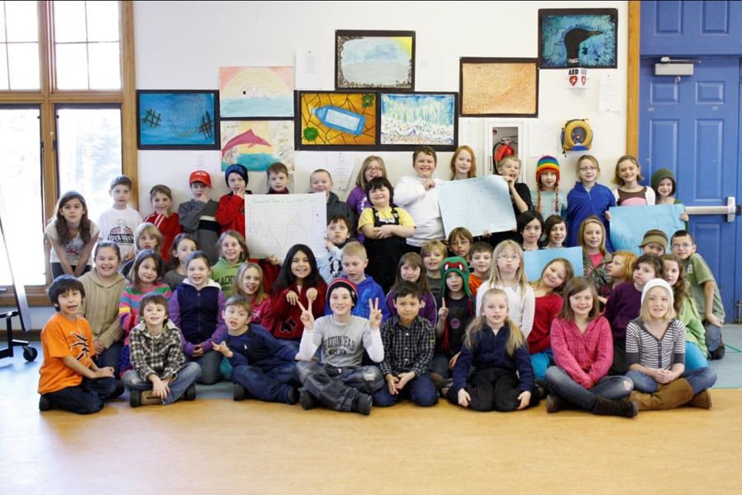
The Students

