Slide 1
Chapter 9 – Linear Regression and Correlation Part II

Slide 2
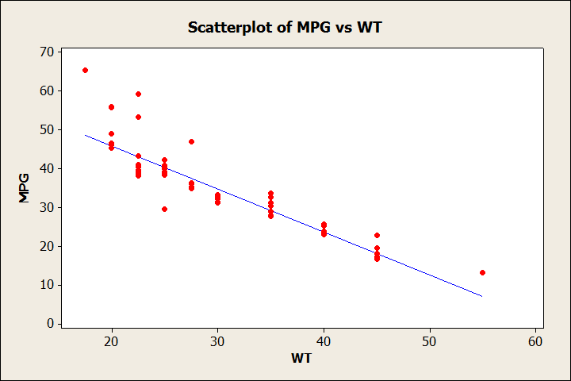
Finding the line of best fit with technology. First, the x variable is called the independent or predictor variable and the y variable is called the dependent or response variable.
Weight is independent or predictor variable
MPG is dependent or response variable

Slide 3
Finding the line of best fit with technology. First, the x variable is called the independent or predictor variable and the y variable is called the dependent or response variable. I get: Y = 6.30 - 0.200 X In TI calculator x1 is x and x2 is y
X | Y
6 | 5
2 | 7
7 | 5
3 | 6
6 | 3
7 | 8
4 | 4
7 | 4

Slide 4
Let McDonalds Count be the explanatory variable and let Nobel Prize Count be the response variable.
What is the linear regression model:
y = 2.499 + 0.021x
y = 24.99 + 0.042x
y = 1.070 + 0.021x
y = 2.335 + 66.839x
Country | Nobel Prize Count | McDonalds Count
Austria | 11 | 148
Czech Republic | 2 | 60
Denmark | 13 | 99
Finland | 2 | 93
Greece | 2 | 48
Hungary | 3 | 76
Iceland | 1 | 3
Ireland | 5 | 62
Luxembourg | 0 | 6
Norway | 8 | 55
Portugal | 2 | 91
Slovakia | 2 | 10
Turkey | 0 | 133
United States | 270 | 12804

Slide 5
You recently found out that the country Vulgaria has 112 McDonald’s Restaurants. Please use the regression model to estimate how many Nobel Prize winners herald from Vulgaria (you can round to the nearest whole number).
Country | Nobel Prize Count | McDonalds Count
Austria | 11 | 148
Czech Republic | 2 | 60
Denmark | 13 | 99
Finland | 2 | 93
Greece | 2 | 48
Hungary | 3 | 76
Iceland | 1 | 3
Ireland | 5 | 62
Luxembourg | 0 | 6
Norway | 8 | 55
Portugal | 2 | 91
Slovakia | 2 | 10
Turkey | 0 | 133
United States | 270 | 12804
14
49
26
5

Slide 6
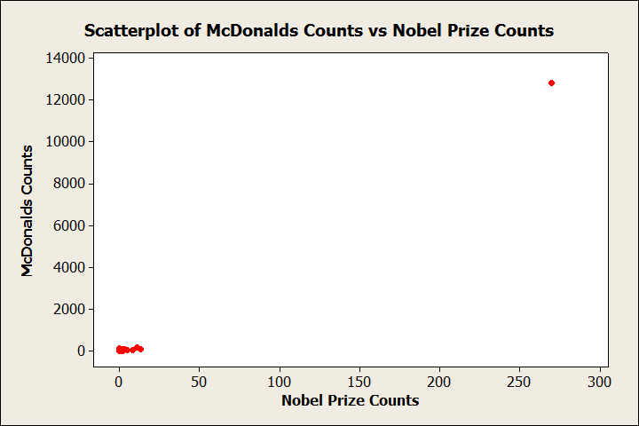
The correlation between McDonalds Count and Nobel Prize Count is very strong. Lets examine the scatter plot!

Slide 7
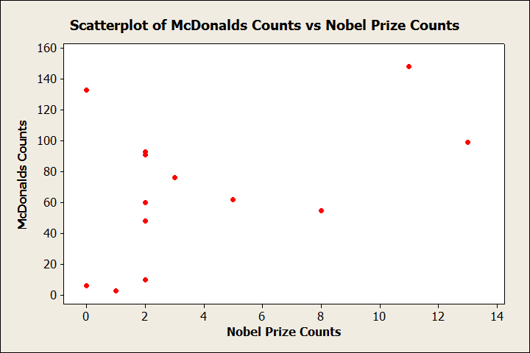
What if we remove the United States from the data?

Slide 8
Boston Marathon Dataset

