Slide 1
Chapter 5 – Discrete random variables Chapter 6 – Continuous random variables

Slide 2
Problems with continuous random variables:
Infinite and uncountable number of outcomes
Can’t list all the outcomes
Can’t use a table to write out the probability distribution
Calculus required for probability calculations

Slide 3
Problems with continuous random variables
What do we do!?
Use technology for probability calculations
Old fashion way – use tabulated probability values in back of book
Use graphs to represent probabilities

Slide 4
Chapter 6 focuses on one continuous distribution – the normal distribution
Normal distribution is also called
Gaussian distribution after Carl Gauss
Bell shaped curve

Slide 5
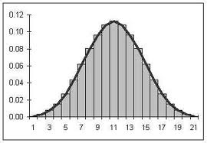
What does the normal distribution look like?

Slide 6
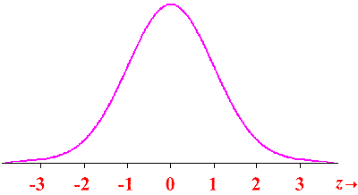
What does the normal distribution look like?

Slide 7
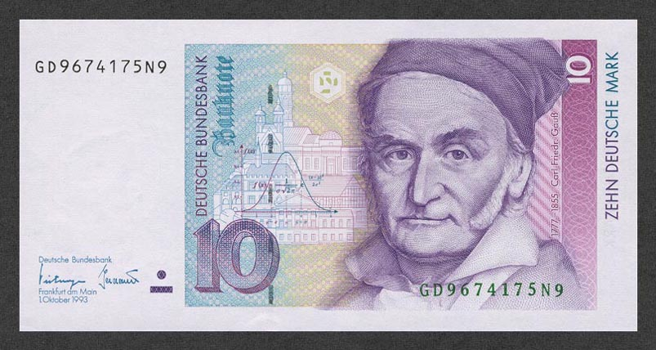

Slide 8
Properties of normal distribution
Bell shaped curve
One mode
Symmetric
Centered at it’s mean, μ
Tails extend out in both directions to $−∞$ and $∞$
Standard deviation is σ

Slide 9
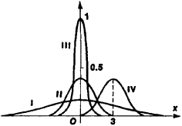
The mean, μ, gives the location
Distributions I, II, and III have a mean, µ = 0

Slide 10
The mean, μ, gives the location
Distribution IV has a mean, µ = 3

Slide 11
The standard deviation, σ, gives the spread or variability
Distribution III has the smallest standard deviation

Slide 12
The standard deviation, σ, gives the spread or variability
Distributions II and IV have equal standard deviations

Slide 13
The standard deviation, σ, gives the spread or variability
Distribution I has the greatest standard deviation

Slide 14
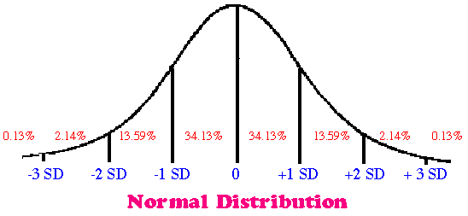
Properties of normal distribution

Slide 15
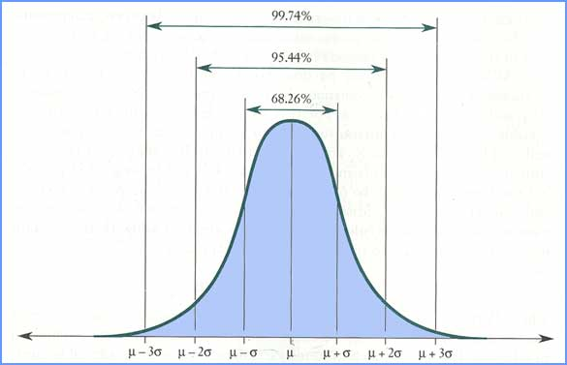
Properties of normal distribution

Slide 16
Let X = uncomplicated human pregnancy length. Assume X has a normal distribution with mean 39 weeks and standard deviation 2 weeks. Approximately how many pregnancies last between 37 and 41 weeks?
About 34%
About 68%
About 95%
About 99.7%
100%

Slide 17
Let X = uncomplicated human pregnancy length. Assume X has a normal distribution with mean 39 weeks and standard deviation 2 weeks. Approximately how many pregnancies last more than 43 weeks?
About 68%
About 34%
About 16%
About 5%
About 2.5%

Slide 18
Let X = uncomplicated human pregnancy length. Assume X has a normal distribution with mean 39 weeks and standard deviation 2 weeks. Approximately how many pregnancies last between 35 and 41 weeks?
About 47.5%
About 50%
About 81.5%
About 95%
About 99.7%

Slide 19
Weights of adult green sea urchins are normally distributed with a mean of 52 g and a standard deviation of 17.2 g. Find the percentage of adult green sea urchins with weights between 50 and 60 grams.
22.54%
11.27%
55.14%
53.27%
Adult green sea urchins taste good

Slide 20
Weights of adult green sea urchins are normally distributed with a mean of 52 g and a standard deviation of 17.2 g. About 12% of adult green sea urchins weigh less than what amount?
50.0 g
72.2 g
31.8 g
34.8 g

Slide 21
The standard normal distribution has a mean $μ=0$ and a standard deviation $σ=1$. It is sometimes called a z distribution

Slide 22
The standard normal distribution is used for calculations – the old fashioned way!

Slide 23
How do we know if a sample of data comes from a normal distribution, or not?
118.5 117.6
120.3 70.6
87.9 101.2
99.5 77.2
125.7 88.1
88.5 116.5
100.5 120.0
104.7 94.7
98.6 94.8
92.6 79.5

Slide 24
How do we know if a sample of data comes from a normal distribution, or not?
We will look at two ways in this class:
Graph the data (histogram) and visually assess the shape. – useful for larger sample sizes, n > 100.
Create a normal probability plot – useful for any sample size.

Slide 25
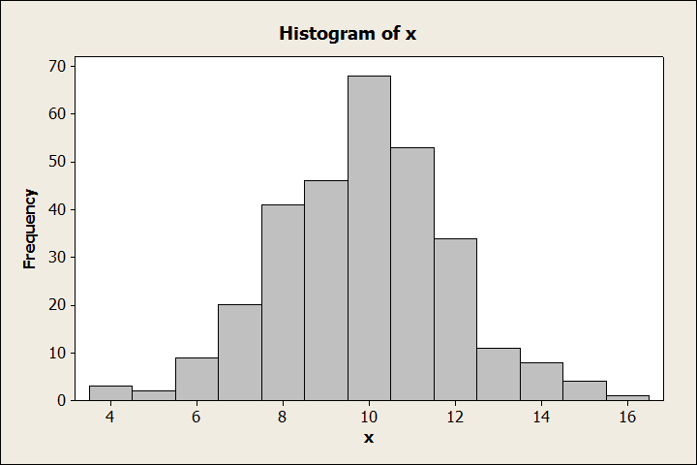
Graph the data. Data is from a normal distribution.
True
False

Slide 26
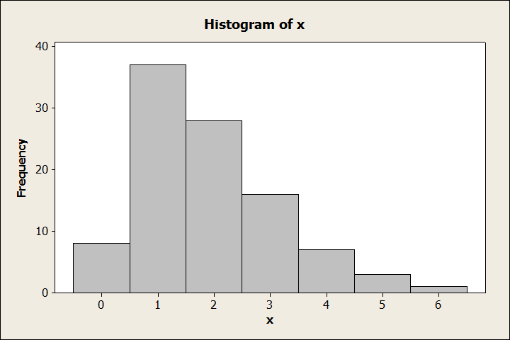
Graph the data. Data is from a normal distribution.
True
False

Slide 27
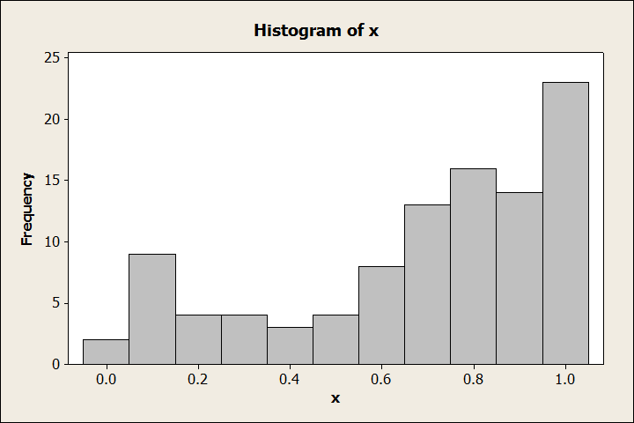
Graph the data. Data is from a normal distribution.
True
False

Slide 28
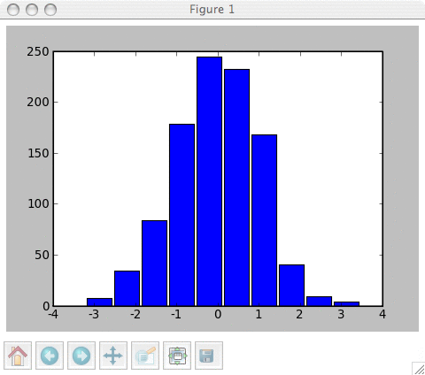
Graph the data. Data is from a normal distribution.
True
False

Slide 29
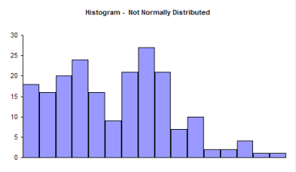
Graph the data. Data is from a normal distribution.
True
False

Slide 30
Create a normal probability plot.
Plot based on the y = x algebra relationship.
The more linear the graph the more likely the data came from a normal distribution.

Slide 31
Create a normal probability plot.
How to make a normal probability plot:
Calculator
Minitab

Slide 32
We can assume this data is from a normal distribution.
13
14
17
13
10
11
13
16
18
18
True
False

Slide 33
We can assume this data is from a normal distribution.
9 19
1 1
3 31
17 2
1 28
4 8
5 20
10
True
False

Slide 34
We can assume this data is from a normal distribution.
3 10
9 6
3 2
2 8
9 10
9 10
9 7
True
False

Slide 35
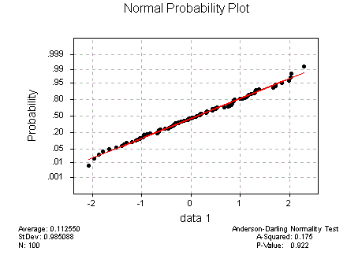
We can assume this data is from a normal distribution.
True
False

Slide 36
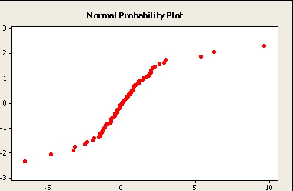
We can assume this data is from a normal distribution.
True
False

Slide 37
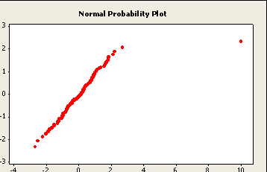
We can assume this data is from a normal distribution.
True
False

