Slide 1
Random Variable: Quantitative variable who’s value depends on chance. Which of the following is not a R.V.?
X = gas mileage of Honda Civic
Y = number of chickens on a farm
Z = first grader’s favorite color
X = sum of two dice when they are rolled
Y = number of times a coin lands on H after 10 flips

Slide 2
Discrete R.V.: a R.V. whose possible values can be (theoretically) listed. Which of the following is not a discrete R.V.?
X = gas mileage of Honda Civic
Y = number of chickens on a farm
Z = how many chickens a first grader has at their house
X = sum of two dice when they are rolled
Y = number of times a coin lands on H after 10 flips

Slide 3
Probability Distribution: A listing of the possible values and corresponding probabilities of a discrete R.V. The following is a valid probability distribution:
x | P(X=x)
1 | 0.05
2 | 0.25
3 | 0.25
4 | 0.25
5 | 0.2
True
False

Slide 4
Probability Distribution: A listing of the possible values and corresponding probabilities of a discrete R.V. The following is a valid probability distribution:
x | P(X=x)
-2 | 0.20
-1 | 0.20
0 | 0.20
3 | 0.20
5 | 0.20
True
False

Slide 5
Probability Distribution: A listing of the possible values and corresponding probabilities of a discrete R.V. The following is a valid probability distribution:
X | P(X=x)
1 | 0.20
2 | - 0.15
3 | 0.40
4 | 0.25
5 | 0.30
True
False

Slide 6
Probability Distribution: A listing of the possible values and corresponding probabilities of a discrete R.V. The following is a valid probability distribution:
X | P(X=x)
1 | 0.30
2 | 0.15
3 | 0.20
4 | 0.15
5 | 0.25
True
False

Slide 7
Consider the following probability distribution. What is P(Y ≤ 2)?
y | 0 | 1 | 2 | 3 | 4 | 5
P(Y = y) | 0.009 | 0.376 | 0.371 | 0.167 | 0.061 | 0.016
0.009
0.385
0.756
0.923
0.984

Slide 8
Consider the following probability distribution. What is the probability Y is not less than 2
y | 0 | 1 | 2 | 3 | 4 | 5
P(Y = y) | 0.009 | 0.376 | 0.371 | 0.167 | 0.061 | 0.016
0.009
0.385
0.756
0.244
0.615

Slide 9
If a probability distribution is known, then the mean of the population can be computed theoretically without collecting any data. Mean of a population is µ Mean of a sample is $\overline{X}$

Slide 10
Compute the population mean using this formula: $μ=\sum{xP(X=x)}$
1.000
1.500
2.000
0.375
0.875
X | 0 | 1 | 2 | 3
P(X = x) | 1/8 | 3/8 | 3/8 | 1/8

Slide 11
Compute the population mean using this formula: $μ=\sum{xP(X=x)}$
y | 0 | 1 | 2 | 3 | 4 | 5
P(Y = y) | 0.009 | 0.376 | 0.371 | 0.167 | 0.061 | 0.016
0.077
1.952
0.747
1.943
1.567

Slide 12
If the first digit, X, in a set of data obeys Benford’s law, the nine possible digits 1 to 9 have probabilities given by the following discrete probability distribution.
The mean or expected value of X is
5.000
3.501
4.959
3.441
None of the above
First digit X | 1 | 2 | 3 | 4 | 5 | 6 | 7 | 8 | 9
Probability | 0.301 | 0.176 | 0.125 | 0.097 | 0.079 | 0.067 | 0.058 | 0.051 | 0.046

Slide 13
The Binomial Distribution:
Experiment consists of n independent trials
Each trial results in a “success” or a “failure”
P(success) = p and P(failure) = 1 – p
X = number of success in n trials.
Example: Flip a fair coin 4 times and let X = number of heads.

Slide 14
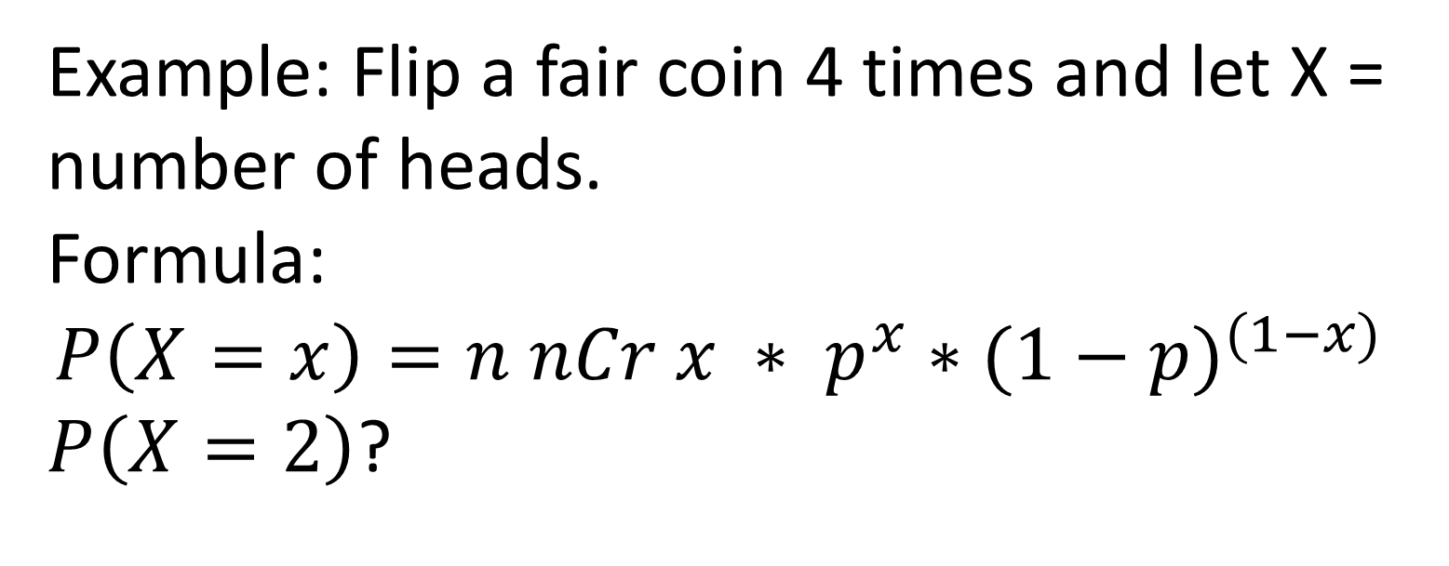
Example: Flip a fair coin 4 times and let X = number of heads. Formula: $$P\left(X=x\right)=n nCr x ∗ p^{x}∗{(1−p)}^{(1−x)}$$ $P\left(X=2\right)$?
0.375
0.875
0.063
0.750
1.500

Slide 15
In a survey of college-age students, 42% reported binge drinking at least once per week (binge drinking is defined as having 5 or more drinks within a one-hour time period). If this percentage holds for the entire population, find, for a random sample of 22 college-age students, the probability that the random sample contains 10 to 12 students inclusive who binge drink at least once per week.
0.0839
0.1264
0.1601
0.3704
None of the above

Slide 16
A student takes a multiple choice exam with 10 questions where each question has 4 answers (one of which is correct). The student forgot to study so just guessed on each question. What is the probability the student gets at least one question correct?
0.9437
0.7560
0.2440
0.0563
None of the above

Slide 17
A student takes a multiple choice exam with 10 questions where each question has 4 answers (one of which is correct). The student forgot to study so just guessed on each question. What is the probability the student passes the exam (60% or better)?
0.0162
0.9803
0.9965
0.0035
.0197

Slide 18
A student takes a multiple choice exam with 10 questions where each question has 4 answers (one of which is correct). The student forgot to study so just guessed on each question. What is the probability the student aces the exam (90% or better)?
0.0000286
0.0000296
0.0000300
0.99997
.0197

