Slide 1
8-12 Algebra and Technology
Dr. Derek Webb
Bemidji State University
dwebb@bemidjistate.edu
Faculty.bemidjistate.edu/dwebb

Slide 2
Introductions
Name
School
Grades you teach
What technologies do you currently use with your students?

Slide 3
Examination of Standards
NCTM
MN
Common Core
Focus on technology that is free (given web access)
Conclusions

Slide 4
Examination of Standards – NCTM

Slide 5
Examination of Standards – NCTM
Algebra Strand
Understand and perform transformations such as arithmetically combining, composing, and inverting commonly used functions, using technology to perform such operations on more-complicated symbolic expressions

Slide 6
Examination of Standards – NCTM
Algebra Strand
Write equivalent forms of equations, inequalities, and systems of equations and solve them with fluency—mentally or with paper and pencil in simple cases and using technology in all cases;

Slide 7
Examination of Standards – NCTM
Algebra Strand
Judge the meaning, utility, and reasonableness of the results of symbol manipulations, including those carried out by technology.

Slide 8
Examination of Standards – MN
Determine how translations affect the symbolic and graphical forms of a function. Know how to use graphing technology to examine translations.

Slide 9
Examination of Standards – MN
Sketch graphs of linear, quadratic and exponential functions, and translate between graphs, tables and symbolic representations. Know how to use graphing technology to graph these functions.

Slide 10
Examination of Standards – MN
Sketch the graphs of common non-linear functions such as $f\left(x\right)= \sqrt{x}$, $f\left(x\right)=|x|$, $f\left(x\right)= \frac{1}{x}$, and $f\left(x\right)= x^{3}$ and translations of these functions. Know how to use graphing technology to graph these functions.

Slide 11
Examination of Standards – MN
Know how to use calculators, graphing utilities or other technology to solve quadratic equations and inequalities.

Slide 12
Examination of Standards – MN
Represent relationships in various contexts using equations involving exponential functions; solve these equations graphically or numerically. Know how to use calculators, graphing utilities or other technology to solve these equations.

Slide 13
NCTM vs. MN Standards
NCTM Standards are broad and encourage multiple solutions
MN Standards are more specific and encourage symbol manipulation.

Slide 14
Examination of Standards – Common Core
Which states have adopted Common Core?
NCTM endorses Common Core
Common Core more similar to NCTM than to MN standards
MN likely to adopt Common Core in future

Slide 15
Free technology on the web
Example:

Slide 17
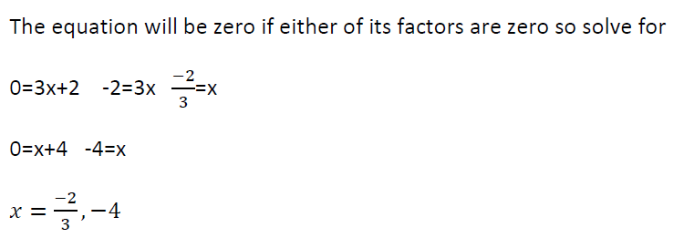
Now, go to Wolfram Alpha and type in the original equation
WolframAlpha website

Slide 18
http://www.meta-calculator.com/online/
Example:

Slide 19
Free technology on the web
Quadratic equation solver
Classic problem: A flare is launched from a boat. The height, h, in meters of the flare above the water is approximately modeled by the function h(t) = –15t^2+150t, where t is the number of seconds after the flare is launched. How many seconds will it take for the flare to return to the water?

Slide 20
Classic problem: A flare is launched from a boat. The height, h, in meters of the flare above the water is approximately modeled by the function h(t) = –15t^2+150t, where t is the number of seconds after the flare is launched. How many seconds will it take for the flare to return to the water?
Follow-up question:
What does the vertex tell us?

Slide 21
Free technology on the web
Example – solve the following: $x^{2}−2x=0$
http://www.algebrahelp.com/calculators/
Will solve the equation and make a graph too.

Slide 22
Free technology on the web
Transformations and inverses of functions
Shifts, reflections, shrinks and stretches
http://members.shaw.ca/ron.blond/TLE/InvFcn.APPLET/index.html

Slide 23
Transformations and inverses of functions
Shifts, reflections, shrinks and stretches
http://members.shaw.ca/ron.blond/TLE/InvFcn.APPLET/index.html
Example: $y= \sqrt{x}$
Inverse?
Shift left by 1 unit?
etc…

Slide 24
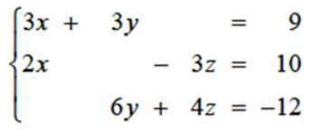
Solving systems of equations
Solve:

Slide 25
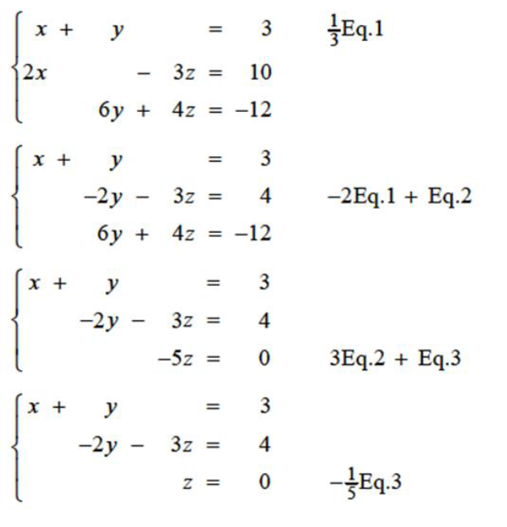

Slide 26
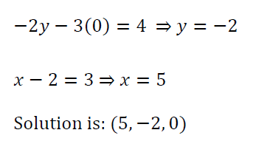
Or use cowpi: http://math.cowpi.com/

Slide 27
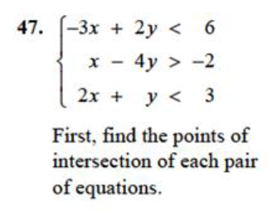
solving systems of inequalities
Solve:

Slide 28
First, it is often useful to graph this system
http://www.quickmath.com/webMathematica3/quickmath/graphs/inequalities/advanced.jsp

Slide 29
Supply and demand problem
Solve: $p=500−0.4x$ Demand
$p=380+0.1x$ Supply
where p is price and x is number of units.
Use Core Math Tools

Slide 30
Synthetic division? Ask Wolfram
$$(3x^{3}−17x^{2}+15x−25)÷(x−5)$$
http://www.wolframalpha.com/

Slide 31
A company that manufactures bicycles estimates that the profit P (in dollars) for selling a particular model is
$P=−45x^{3}+2500x^{2}−275,000$ for $0≤x≤50$
where x is the advertising expense (in tens of thousands of dollars). Find the smaller of the two advertising amounts that will yield a profit of $800,000.

